Slide 1
High‐accuracy electronic structure theory in support of spectroscopy
Anastasia Borschevsky
VSI, University of Groningen

Slide 2






Yangyang Guo

Slide 3
University of Groningen
Research:
Using computational chemistry tools to address fundamental problems in physics:
Search for new physics with low-energy precision measurements
  Violation of fundamental symmetries in atoms and in molecules
  Search for variation of fundamental constants
Highly accurate calculations of spectra and properties of heavy and superheavy atoms and molecules and highly charged ions
Most work done in collaboration with experimental groups

Slide 4
University of Groningen
Research:
Using computational chemistry tools to address fundamental problems in physics:
Search for new physics with low-energy precision measurements
  Violation of fundamental symmetries in atoms and in molecules
  Search for variation of fundamental constants
Highly accurate calculations of spectra and properties of heavy and superheavy atoms and molecules and highly charged ions
Most work done in collaboration with experimental groups

Slide 5
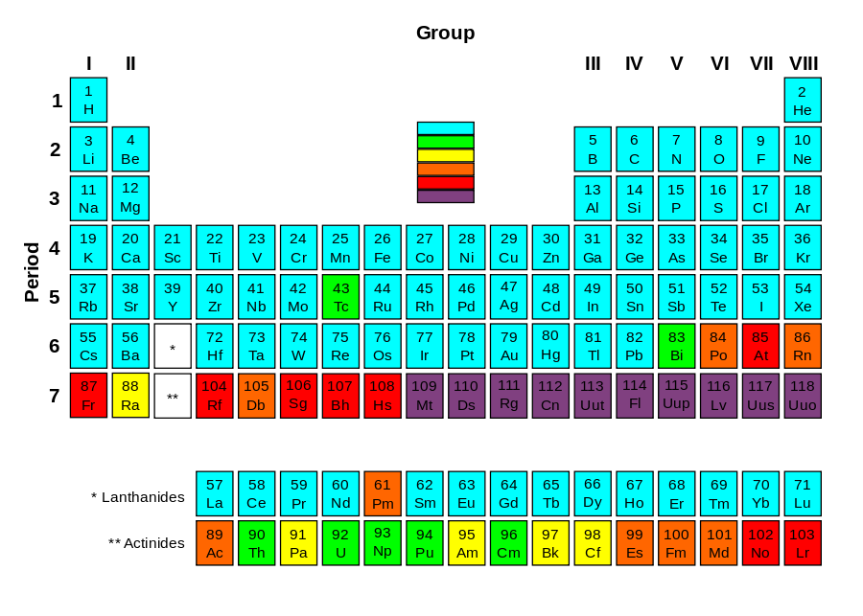
Experiments on heavy and/or unstable elements
Extremely challenging:
  Low production rates (down to a few atoms per month)
  Radioactive elements
  Short lifetimes (sometimes just minutes or seconds)
103 yrs. > t_{1/2} >1 day
1 day > t_{1/2}>1 min.
1 min. > t_{1/2}

Slide 6
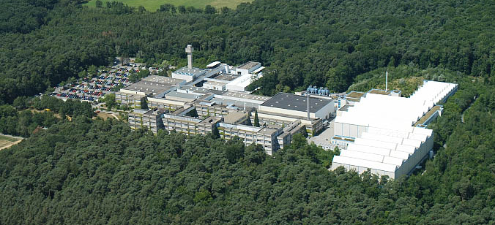
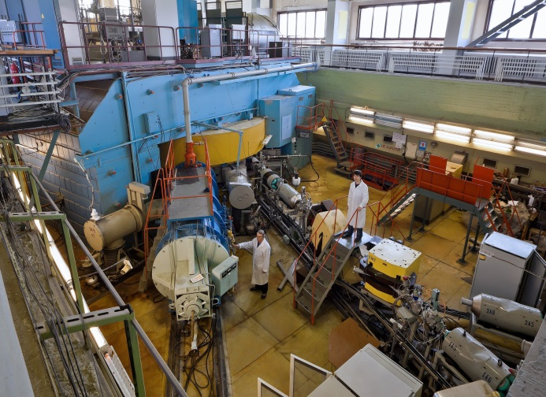
Experiments on heavy and/or unstable elements
Extremely challenging:
  Low production rates
  Short lifetimes
  Radioactive elements
  Expensive, large scale, long term experiments

Slide 7
Experiments on heavy and/or unstable elements
Success of such studies requires a combination of novel, fast, and sensitive experimental methods and theoretical support

Slide 8
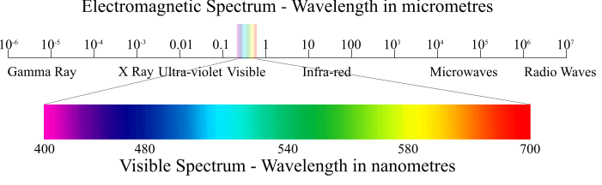
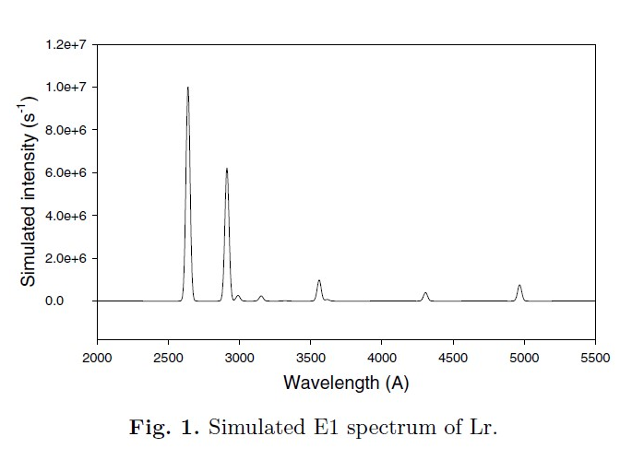
Theory can provide:
  Reliable predictions for planning the measurements:
    Spectroscopy: predictions of transition energies and intensities
    Laser cooling: promising schemes
    etc…

Slide 9
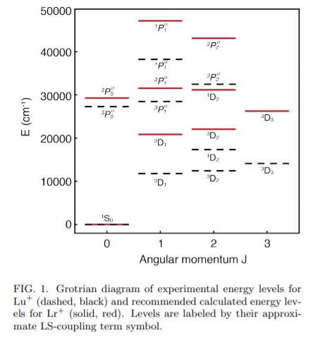
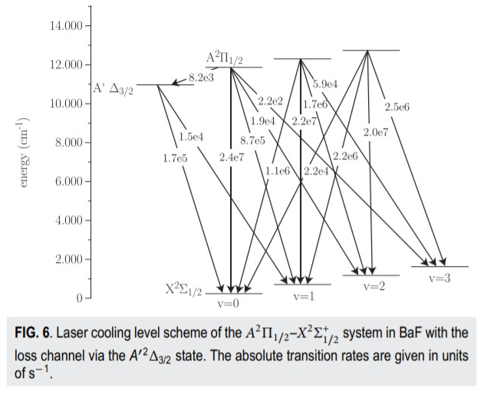
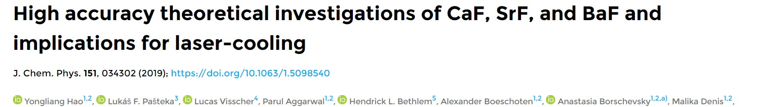
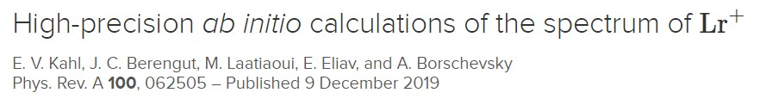
Theory can provide:
  Reliable predictions for planning the measurements:
    Spectroscopy: predictions of transition energies and intensities
    Laser cooling: promising schemes
    etc…

Slide 10
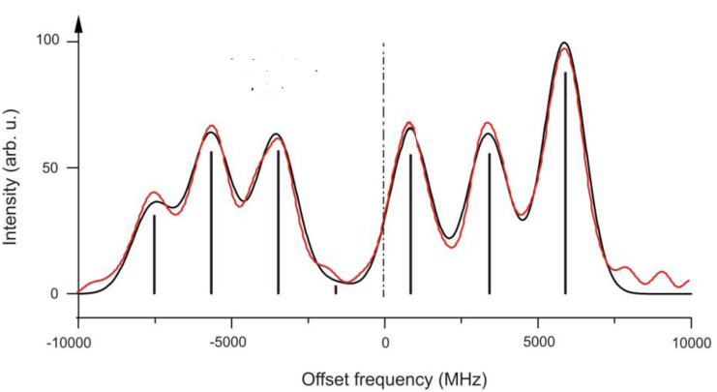
Theory can provide:
  Reliable predictions for planning the measurements
  Extraction of data from measurements
    Electronic structure factors for extracting nuclear parameters from hfs measurements
    Coupling constants to interpret precision measurements (e.g. extract eEDM from measured energy shifts, etc)
Hyperfine structure:
B=eQ_{s}q

Slide 11
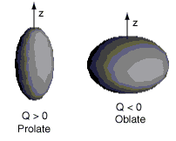
Theory can provide:
  Reliable predictions for planning the measurements
  Extraction of data from measurements
    Electronic structure factors for extracting nuclear parameters from hfs measurements
    Coupling constants to interpret precision measurements (e.g. extract eEDM from measured energy shifts, etc)
Hyperfine structure:
B=eQ_{s}q
Theoretical input
Measured

Slide 12
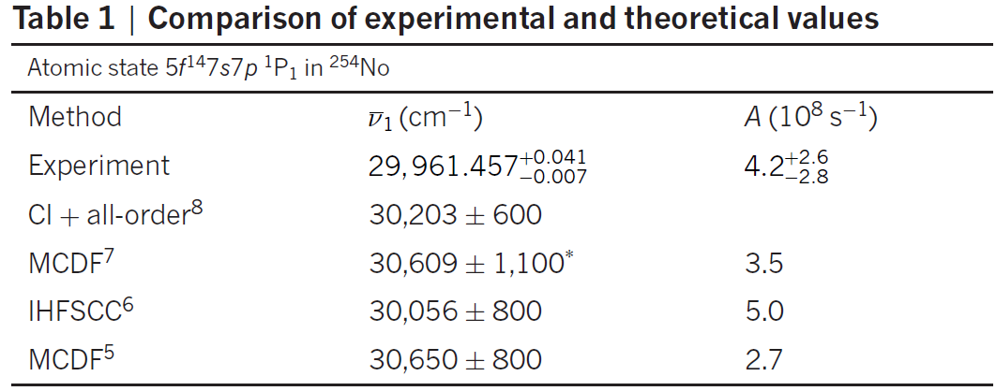
Theory can provide:
  Reliable predictions for planning the measurements
  Extraction of data from measurements
  Predictions for comparison
M. Laatiaoui et al., Nature 538, 495 (2016)

Slide 13
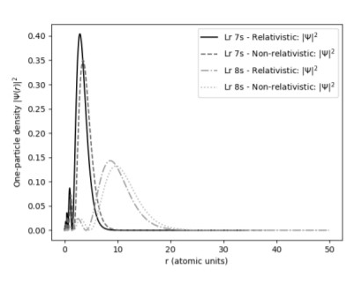
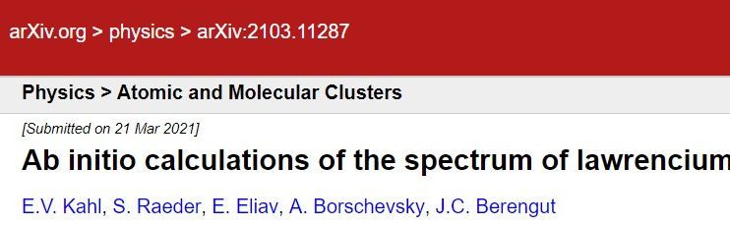
Theory can provide:
  Reliable predictions for planning the measurements
  Extraction of data from measurements
  Predictions for comparison
  Interpretation of results

Slide 14
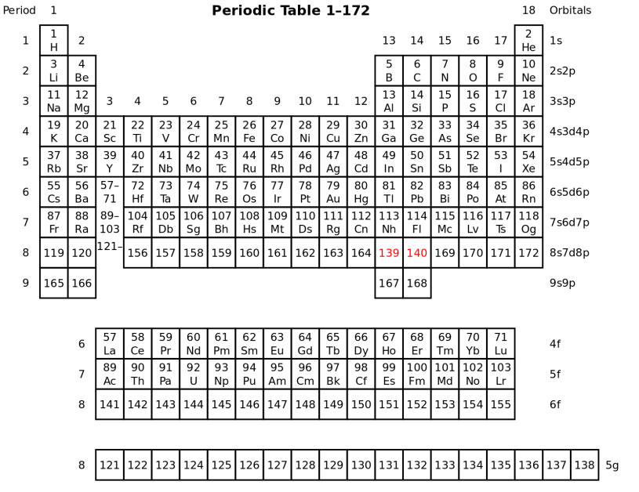
Theory can provide:
  Reliable predictions for planning the measurements
  Extraction of data from measurements
  Predictions for comparison
  Interpretation of results
  Investigation of properties or trends where no experiment is (yet) available
P. Pyykko, PCCP 13, 161 (2011)

Slide 15
What can we calculate?
  Atomic properties: IPs, EAs, spectra, hyperfine structure parameters, polarisabilities, …
  Molecular properties: geometries, molecular parameters, electronic structure, Franck-Condon Factors (FCFs), transition strengths…
  Specific properties: coupling parameters describing the sensitivity of the atom/molecule to “new physics” effects (eEDM, parity violation, nuclear anapole moment, variation of fundamental constants, etc.)…
  Basically, anything that is needed (new operators need to be implemented)

Slide 16
In order to be useful in experimental context:
  Predictions should be based on high accuracy, reliable calculations
  Preference for ab initio methods without fitting parameters (predictive power)
  We need to understand the capabilities and limitations of the method
  Transparent methods (possibility of assigning uncertainties)

Slide 17
In order to be useful in experimental context:
  Predictions should be based on high accuracy, reliable calculations
  Preference for ab initio methods without fitting parameters (predictive power)
  We need to understand the capabilities and limitations of the method
  Transparent methods (possibility of assigning uncertainties)
  Choice of computational method becomes crucial

Slide 18


Computational methods

Slide 19
Computational methods
Hamiltonian (treatment of relativity)
Treatment of correlation (interaction between electrons)
Choice of basis set (WF)

Slide 20
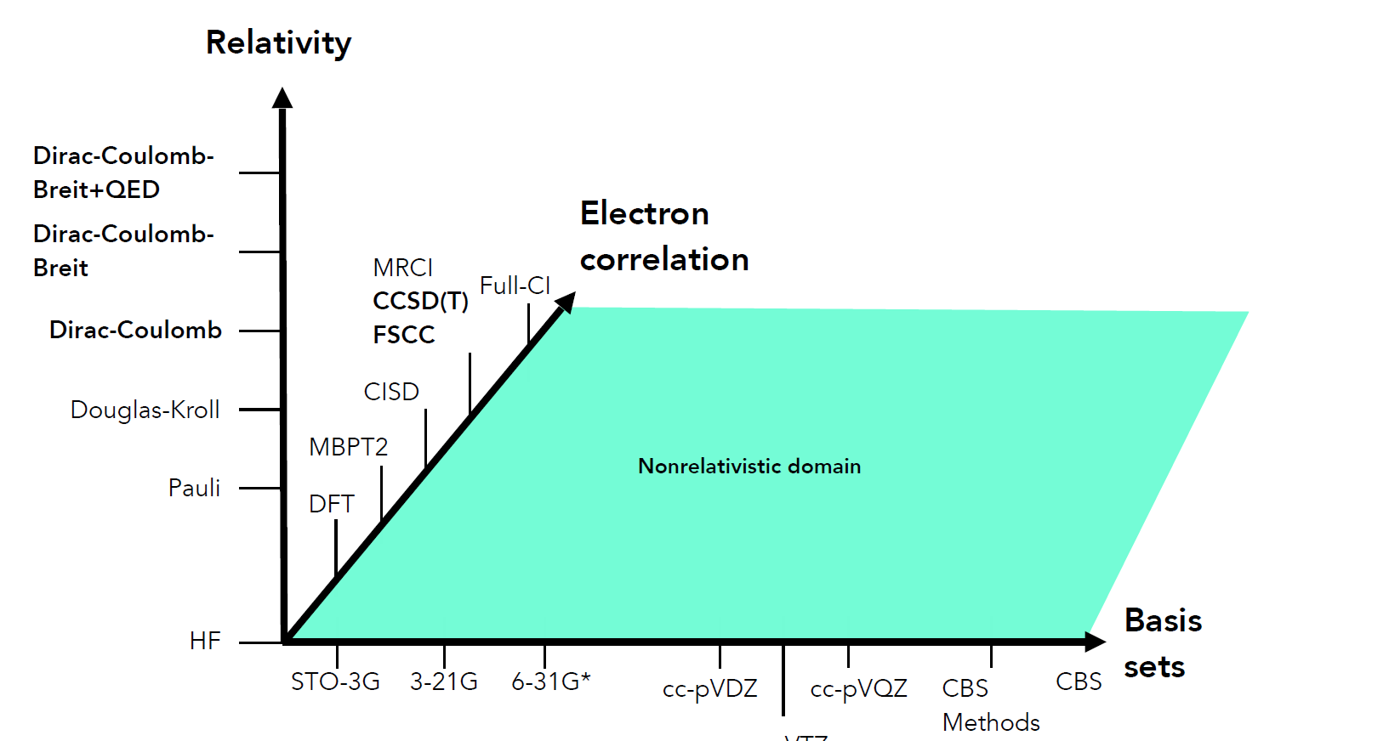
Computational methods
Compromise between accuracy and computational costs
Figure courtesy of P.Schwerdtfeger

Slide 21
Computational methods
Compromise between accuracy and computational costs
Choice of method will depend on the problem and the desired accuracy
?
Figure courtesy of P.Schwerdtfeger

Slide 22
Relativity

Slide 23
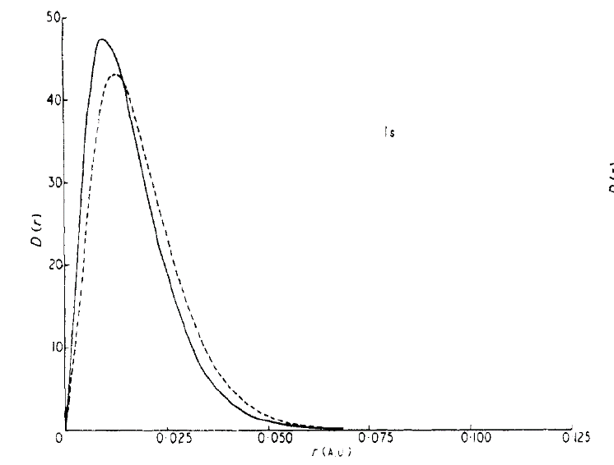
Relativity
Relativistic mass increase (due to finite speed of light):
Effective Bohr radius:
For hydrogen, v≈0.008c
For a hydrogen-like atom with Z=80, radial velocity 58% of c, electron mass increase of 23 %, orbital contraction ~20%
----- NR
___ R
P. Pyykko, Chem. Rev. 88, 563 (1988)

Slide 24
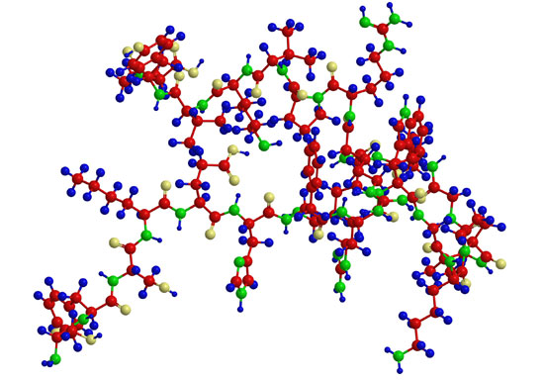
Relativity
P.A.M.Dirac (Proc. Roy. Soc. Lond. A 123 (1929) 714): The general theory of quantum mechanics is now almost complete, the imperfections that still remain being in connection with the exact fitting of the theory with relativity ideas. These gives rise to difficulties only when high-speed particles are involved, and are therefore of no importance in the consideration of atomic and molecular structure and ordinary chemical reactions, in which it is, indeed, usually sufficiently accurate if one neglects relativity variation of mass with velocity and assumes only Coulomb forces between the various electrons and atomic nuclei.
Most computational chemistry is concerned with light elements (C, H, O, N, etc) and hence non-relativistic

Slide 25
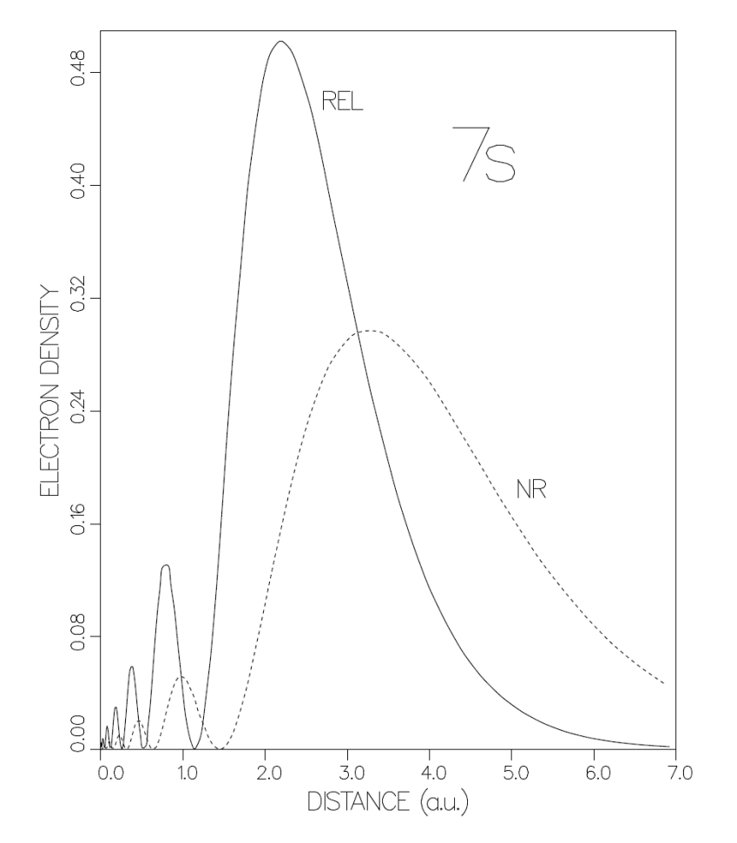
Relativity
Direct effect: relativistic contraction, similar (or even larger!) in magnitude for higher s shells (and also p_{1/2})
E(a.u.) | R | NR | %
Hg, 6s | -0.328 | -0.260 | 2.1
Hg, 1s | -3074.235 | -2778.685 | 0.98
Rg
E. Eliav, U. Kaldor, P. Schwerdtfeger, B. Hess, Y. Ishikawa, PRL.73, 3203 (1994).

Slide 26
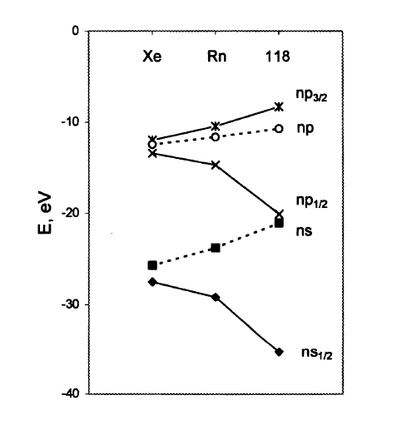
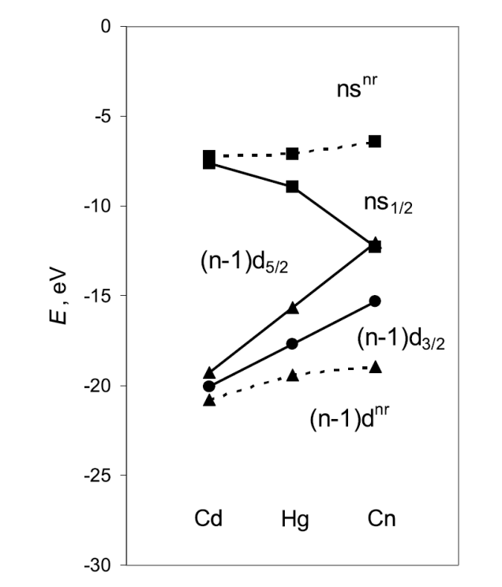
Relativity
Spin-orbit splitting
R
NR
R
NR
R
V. Pershina, in Theoretical Chemistry and Physics of the superheavy elements (2003)
V. Pershina ,
Nuclear Physics A 944 (2015) 578–613

Slide 27
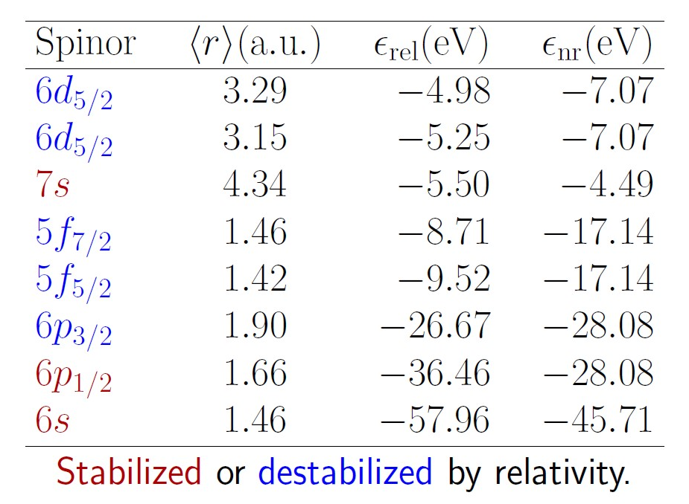
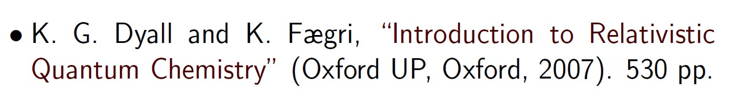
Relativity
U atom

Slide 28
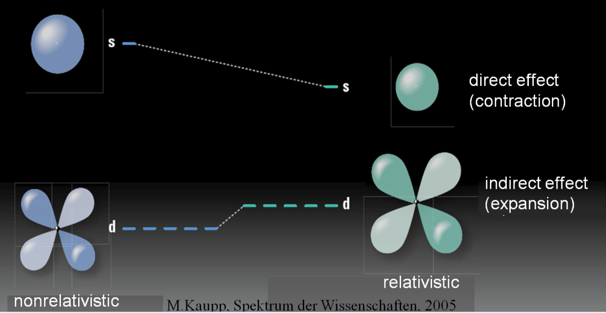
Relativity
Indirect effect: destabilization of the d and f orbitals

Slide 29
Relativity
Au |  |  | NR | R | Exp.
IP | 5d¹⁰6s | ²S_{1/2} | 7.06 | 9.21 | 9.23
EE | 5d⁹6s² | ²D_{3/2} | 5.30 | 2.66 | 2.66
 | 5d⁹6s² | ²D_{5/2} | 5.30 | 1.12 | 1.14
EA | 5d¹⁰6s² | ¹S₀ | 1.28 | 2.29 | 2.31

Slide 30
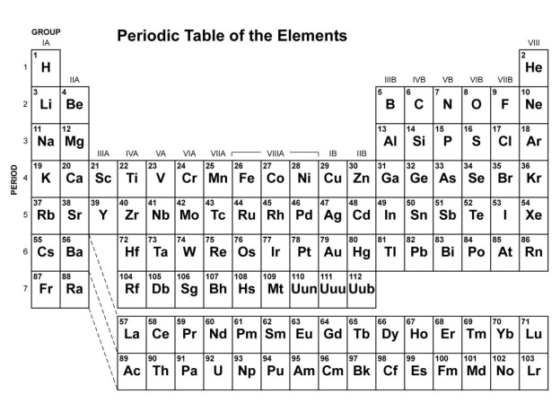
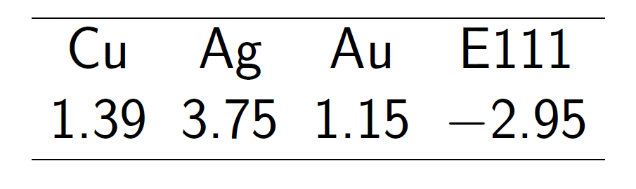
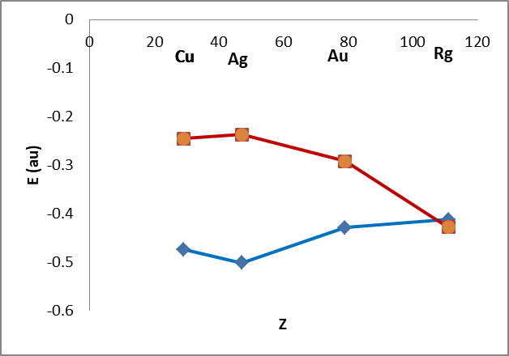
Relativity
²S_{1/2}→²D_{5/2} [(n-1)d¹⁰ns→(n-1)d⁹ns²] (eV)
eV |  |  | NR | R | Exp.
 | 5d⁹6s² | ²D_{5/2} | 5.30 | 1.12 | 1.14
ns
P. Pyykk, J. P. Desclaux, Acc. Chem. Res. 1979, 12, 276 – 281.
nd_{5/2}
Eliav et al., PRL 73, 3203 (1994)

Slide 31
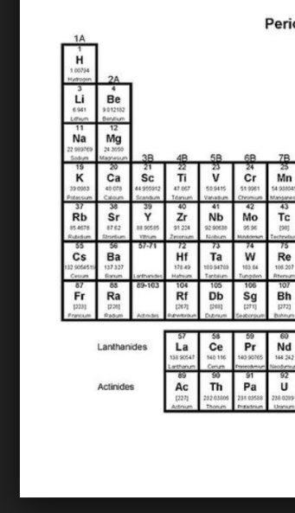
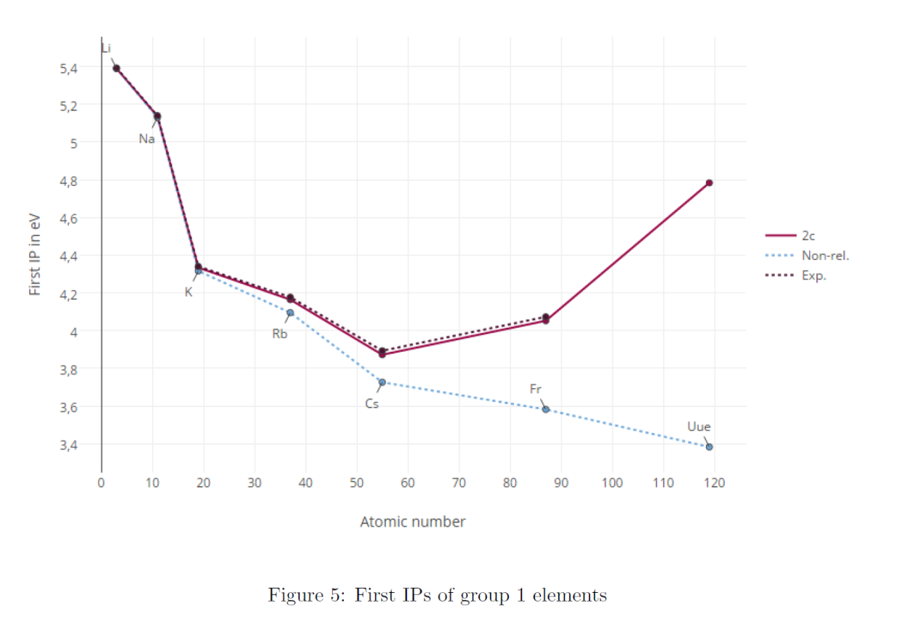
Relativity
Ionization potentials of group 1 elements:
ns
119
J. M De Wit, Bachelor Thesis, 2016

Slide 32

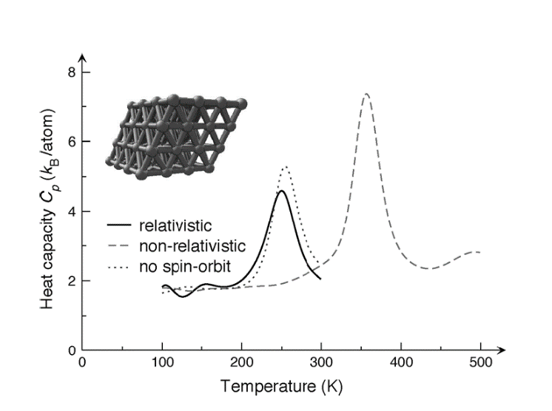
Relativity
Mercury is liquid due to relativity

Slide 33
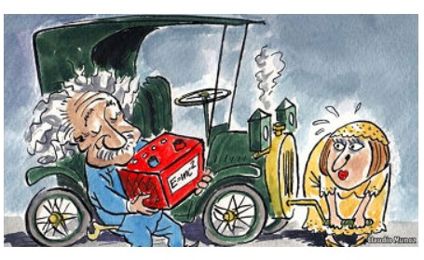

Relativity
Lead-acid batteries work because of relativity

Slide 34
Relativity
Crucial for describing
  heavy elements

Slide 35
Relativity
Crucial for describing
  heavy elements
  highly-charged ions

Slide 36
Relativity
Crucial for describing
  heavy elements
  highly-charged ions
  properties dominated by nuclear region (e.g. HFS parameters)

Slide 37
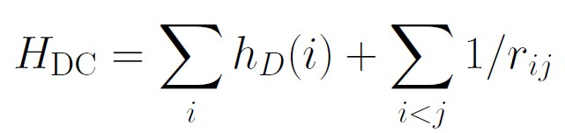

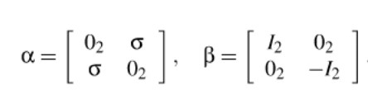
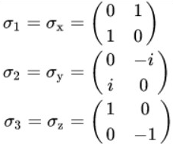
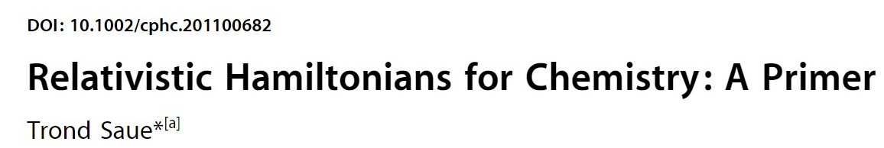



Relativistic framework
4-c Dirac-Coulomb-Hamiltonian:
α_{i}, β - four dimensional Dirac matrices

Slide 38
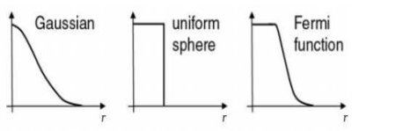
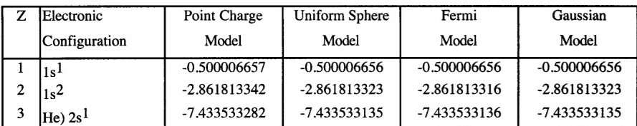
Relativistic framework
4-c Dirac-Coulomb-Hamiltonian:
Finite nuclear model should be used; the results are not sensitive to the choice of model.

Slide 39
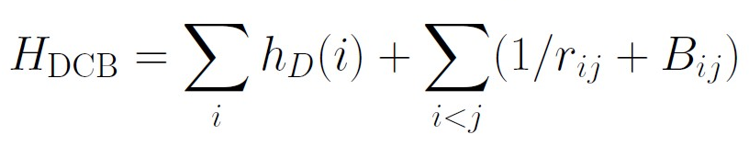
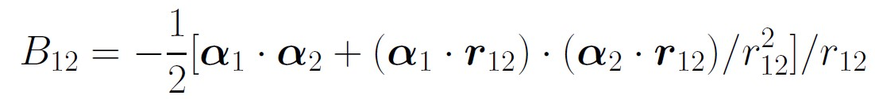
Relativistic framework
4-c Dirac-Coulomb-Breit Hamiltonian:
Contribution: 10s-100s cm⁻¹ for transitions in neutral atoms, 1000s cm⁻¹ in highly charged ions

Slide 40
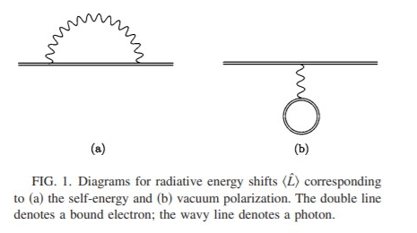

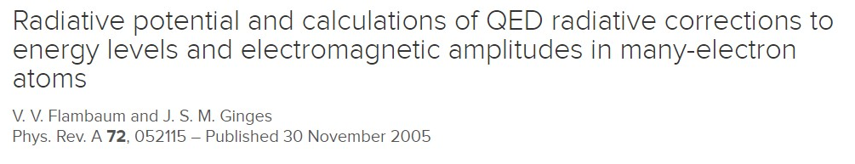

Relativistic framework
QED corrections: Lamb shift, calculated with model potentials, 100s of cm⁻¹

Slide 41

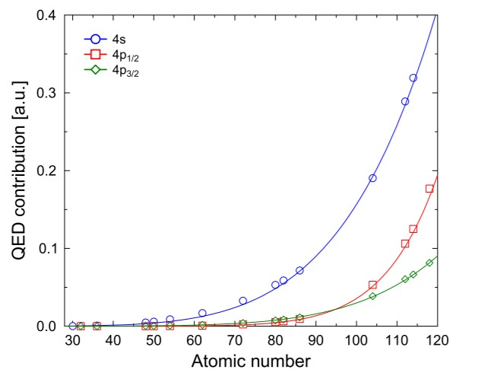
Relativistic framework
QED corrections: Lamb shift, calculated with model potentials, 100s of cm⁻¹

Slide 42
Relativistic framework
Finite nucleus
Breit and QED effects either included or added a posteriori

Slide 43
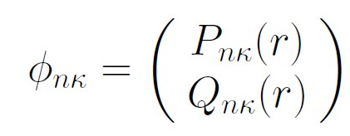
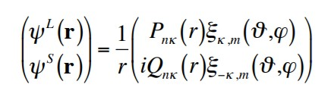

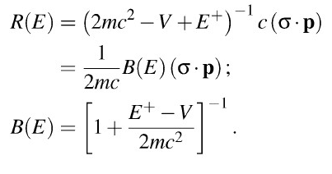
Relativistic framework
For atoms, spherical symmetry leads to separation of the one electron equation into radial and spin-angular parts. The radial four-spinor:
P_{nk} and Q_{nk} are multiplied by the 2-component spin-angular functions
Solve the Dirac equation using a method of choice

Slide 44

Relativistic framework
Approximations: 2-component approaches, in particular X2C (exact relativistic 2-component Hamiltonian). Results typically within single % from the 4c numbers
Effect of relativity: perform NR calculations either in NR framework, or, for better comparison, in relativistic code, setting c to a very big number

Slide 45
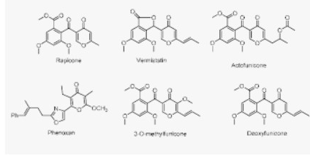
Computational methods
Compromise between accuracy and computational costs
Choice of method will depend on the problem and the desired accuracy
Figure courtesy of P.Schwerdtfeger

Slide 46
Computational methods
Compromise between accuracy and computational costs
Choice of method will depend on the problem and the desired accuracy
Figure courtesy of P.Schwerdtfeger

Slide 47
Computational methods
Compromise between accuracy and computational costs
Choice of method will depend on the problem and the desired accuracy
Figure courtesy of P.Schwerdtfeger

