Slide 1
High‐accuracy electronic structure theory in support of spectroscopy
Anastasia Borschevsky
VSI, University of Groningen

Slide 2
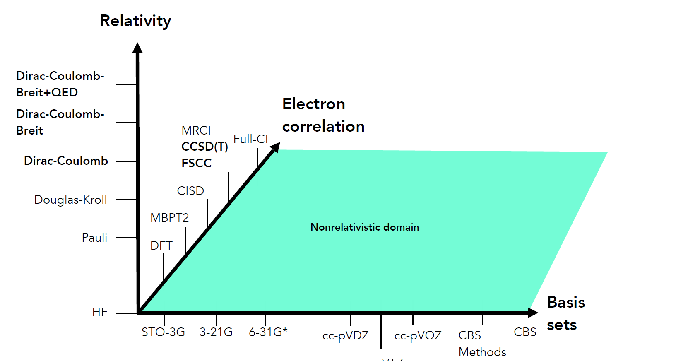
Computational methods
Compromise between accuracy and computational costs
Choice of method will depend on the problem and the desired accuracy
Figure courtesy of P.Schwerdtfeger

Slide 3
Harteree-Fock approach
The physical model of the Hartree-Fock model: every electron in the atom moves in the field of the nucleus and the average distribution of the other electrons. This definition points at the need for iterative approach, because the distribution of the other electrons requires knowledge of their orbitals.

Slide 4
Hartree-Fock approach
Use antisymmetric form of the WF (antisymmetrised product of 1-e⁻ spin-orbitals):
Atomic Hamiltonian:

Slide 5
Hartree-Fock approach
Use antisymmetric form of the WF (antisymmetrised product of 1-e⁻ spin-orbitals):
Atomic Hamiltonian:

Slide 6
Hartree-Fock approach
Find energy expectation value:
$$E_{HF}=\sum_{i}{\left\langle i | h | i\right\rangle +\frac{1}{2}\sum_{i<j}{[\left(ii | jj\right)−\left(ij | ji\right)]}}$$
$$E=\left\langle Ψ | H | Ψ\right\rangle$$

Slide 7
Hartree-Fock approach
Variation theory:
$$E_{HF}=\sum_{i}{\left\langle i | h | i\right\rangle +\frac{1}{2}\sum_{i<j}{[\left(ii | jj\right)−\left(ij | ji\right)]≥E_{exact}}}$$
So, we need to minimize E_{HF}!
This is equivalent to optimizing the 1-electron orbitals, χ_{i}
$E=\left\langle Ψ_{trial} | H | Ψ_{trial}\right\rangle ≥E_{exact}$= $\left\langle Ψ_{true} | H | Ψ_{true}\right\rangle$

Slide 8
Hartree-Fock approach
After some manipulations, we arrive at HF equations:

Slide 9
Hartree-Fock approach
Define the Fock operator:
This operator has explicit dependence on the orbitals and hence we can not solve the problem analytically

Slide 10
Hartree-Fock approach
Use iterative procedure:

Slide 11
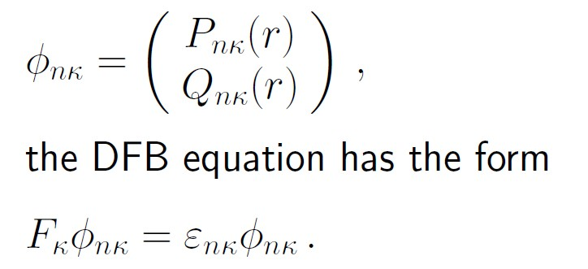
Hartree-Fock approach
The same procedure is followed in the DCB method, but HF
orbitals are replaced by 4-component DFB spinors, the 1-e part
is the Dirac h_{D}, and the 1/r_{ij} operator is modified by the Breit
B_{ij}.

Slide 12
Computational methods
Compromise between accuracy and computational costs
Choice of method will depend on the problem and the desired accuracy
Figure courtesy of P.Schwerdtfeger

Slide 13
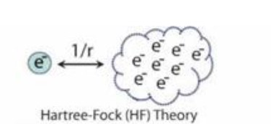
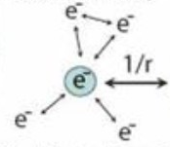
Electron correlation
Hartree-Fock replaces the instantaneous electron-electron repulsion with the repulsion of each electron with an average electron charge cloud.
In HF the electrons are allowed to approach each other too closely; thus repulsion is overestimated
This introduces an error in the wavefunction and the energy. The energy error is called the correlation energy.
Correlation

Slide 14
Electron correlation
Hartree-Fock replaces the instantaneous electron-electron repulsion with the repulsion of each electron with an average electron charge cloud.
In HF the electrons are allowed to approach each other too closely; thus repulsion is overestimated
This introduces an error in the wavefunction and the energy. The energy error is called the correlation energy.
The error in the total energy is about 1 eV per electron pair in a bond or lone pair.
Correlation energy will always be negative (E_{exact}-E_{HF} <0)

Slide 15
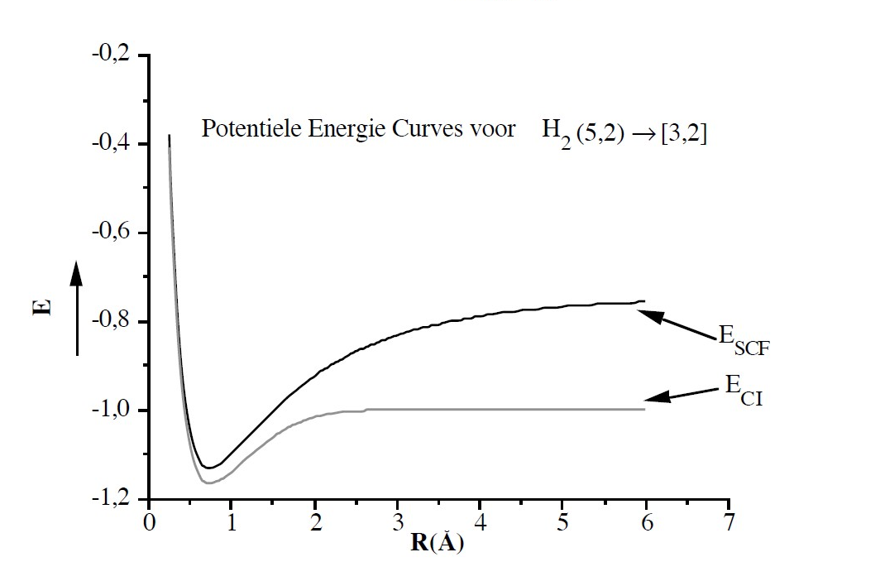
Electron correlation
HF-type functions are useless for most quantitative predictions.
(e.g., binding energies in molecules low by 30- 70%.
In some cases, qualitatively incorrect results:
H₂ molecule dissociates into H+H or H⁺+H⁻ with equal probability. Similar behaviour for most molecules.
No bound negative ions

Slide 16
Electron correlation
Accurate description of interaction between the electrons (beyond Hartree-Fock model)
Important for light and for heavy elements and for all properties
Formidable problem, different approaches available

Slide 17
Configuration interaction
In HF we have a single Slater determinant
If we had an infinite number of Slater determinants (complete set), we could obtain the exact n-electron WF
Perhaps find an in-between solution and use a finite number of determinants?

Slide 18
Configuration interaction
Take 2m SO for an n electron system (2m>n)
This means that some orbitals will be occupied and some will remain vacant
Construct all possible determinants:

Slide 19
Configuration interaction
Example: Be atam 1s²2s², 4 electrons. Take 1s, 2s, 2p, and 3s orbitals (2m=12)
3s
3s
3s
2p
2p
2p
2s
2s
2s
1s
1s
1s
3s
3s
2p
2p
2s
2s
1s
1s

Slide 20
Configuration interaction
Use the constructed determinants as a basis for the CI WF:
3s
3s
3s
2p
2p
2p
2s
2s
2s
1s
1s
1s
3s
3s
2p
2p
2s
2s
1s
1s

Slide 21
Configuration interaction
Use the constructed determinants as a basis for the CI WF:
3s
3s
3s
2p
2p
2p
2s
2s
2s
1s
1s
1s
3s
3s
2p
2p
2s
2s
1s
1s

Slide 22
Configuration interaction
Use the constructed determinants as a basis for the CI WF
Calculate coefficients c_{i} that minimize the energy (solve linear variational problem via secular determinant)
In total, we will get M optimised states
This is full CI: the most accurate description within a given number of orbitals, but unrealistic

Slide 23
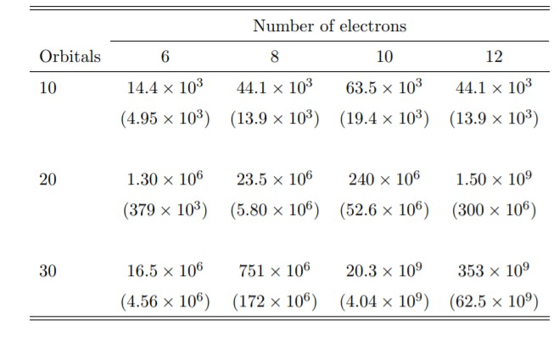
Configuration interaction
Use the constructed determinants as a basis for the CI WF
Calculate coefficients c_{i} that minimize the energy (solve linear variational problem via secular determinant)
In total, we will get M optimised states Ψ_{i} with corresponding E_{i}
This is full CI: the most accurate description within a given number of orbitals, but unrealistic

Slide 24
Configuration interaction
To reduce computational costs:
Truncate excitations (CISD/CISDT):
Truncate active space:

Slide 25
Configuration interaction
To reduce computational costs:
Truncate excitations (CISD/CISDT):
Truncate active space:
And other tricks…

Slide 26
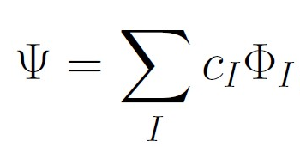
Multiconfigurational HF
Take a smaller number of determinants
Optimise both the c_{I} coefficients and the 1-electron orbitals in each step
Greater flexibility, but more expensive
Thought needed for selecting the determinants

Slide 27
Coupled cluster
Exponential representation of the wave operator:
Here, S is the excitation operator, usually truncated at S₂ or S₃:
Coupled cluster equations:

Slide 28
Coupled cluster
Exponential representation of the wave operator:
Here, S is the excitation operator, usually truncated at S₂ or S₃:
Compare with CI:
The advantage of CC is in the exponential form: for the same truncation, higher rank excitations included

Slide 29
Many more methods
Various PT approaches
DFT
…
Also, we can combine different methods (e.g. CI+MBPT)

Slide 30
Relativistic calculations in the context of atomic spectroscopy (of heavy elements)
Relativistic CI (or CI+MBPT)
M. Safronova and S. Porsev (U. Delaware), V. Dzuba and J. Berengut (UNSW, Sydney)
Multiconfigurational Dirac-Fock (MCDF)
S. Fritzsche (Jena), M. R. Godfroid (Brussels), J. Bieron (Krakow)
Relativistic coupled cluster
B. Sahoo (Ahmedabad), L. Skripnikov (St. Petersburg), A. Borschevsky (Groningen), E. Eliav (Tel Aviv)

Slide 31
Relativistic calculations in the context of atomic spectroscopy (of heavy elements)
Relativistic CI (or CI+MBPT)
M. Safronova and S. Porsev (U. Delaware) , V. Dzuba and J. Berengut (UNSW, Sydney)
Multiconfigurational Dirac-Fock (MCDF)
S. Fritzsche (Jena), M. R. Godfroid (Brussels), J. Bieron (Krakow),
Relativistic coupled cluster
B. Sahoo (Ahmedabad), L. Skripnikov (St. Petersburg), A. Borschevsky (Groningen), E. Eliav (Tel Aviv)

Slide 32
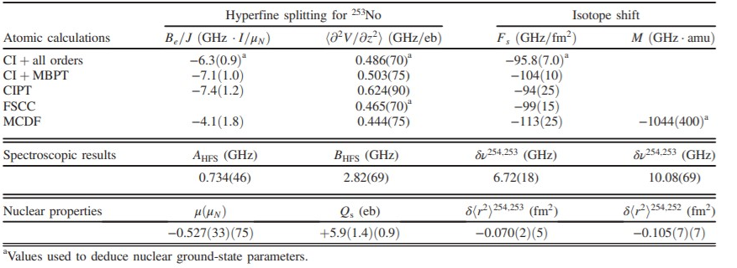
Relativistic calculations in the context of atomic spectroscopy (of heavy elements)
Relativistic CI (or CI+MBPT)
M. Safronova and S. Porsev (U. Delaware) , V. Dzuba and J. Berengut (UNSW, Sydney)
Multiconfigurational Dirac-Fock (MCDF)
S. Fritzsche (Jena), M. R. Godfroid (Brussels), J. Bieron (Krakow),
Relativistic coupled cluster
B. Sahoo (Ahmedabad), L. Skripnikov (St. Petersburg), A. Borschevsky (Groningen), E. Eliav (Tel Aviv)

Slide 33
Computational methods
Compromise between accuracy and computational costs
Choice of method will depend on the problem and the desired accuracy
Figure courtesy of P.Schwerdtfeger

Slide 34
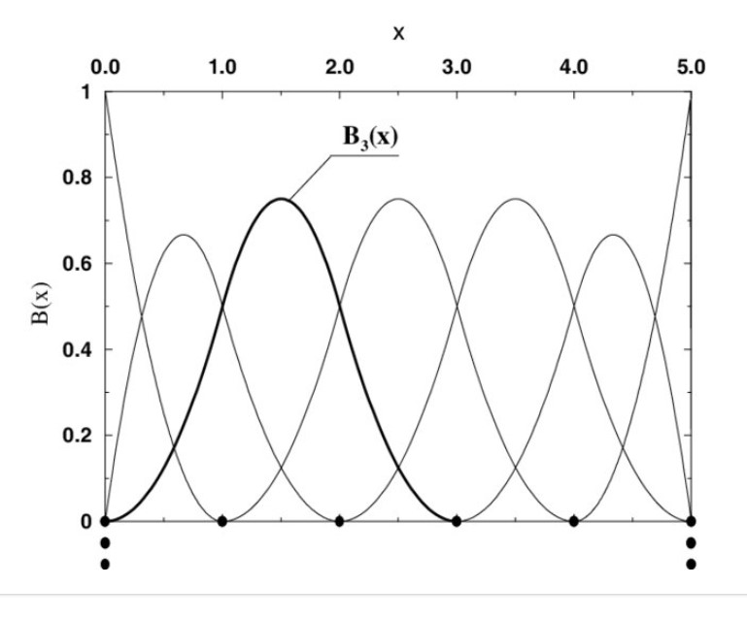
Basis sets
Many atomic codes will use numerical methods or B-splines
Molecular programs (no spherical symmetry) and some atomic codes use basis sets.

Slide 35
Basis sets
Sets of functions that are used to represent the atomic orbitals.
Optimising the orbitals = optimising the coefficients
N→ ∞ complete basis set limit (not an approximation)
In practice: finite basis sets (approximation)
Criteria for selecting basis functions:
i) They should be physically meaningful.
ii) Computation of the integrals should be feasible.

Slide 36
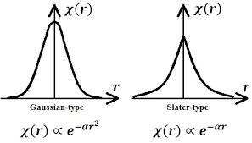
Basis sets
Sets of functions that are used to represent the electronic WF.
STO vs. GTO

Slide 37
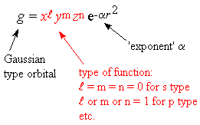
Basis sets
Basis set quality:
nξ: double zeta (2z, 2 functions per occupied orbital), triple zeta (3z, 3 functions, etc.)
Tight (high exponent) Gaussians needed to describe the nuclear region; diffuse (low exponent) Gaussians for bonding
Atom specific, different basis sets for different properties

Slide 38
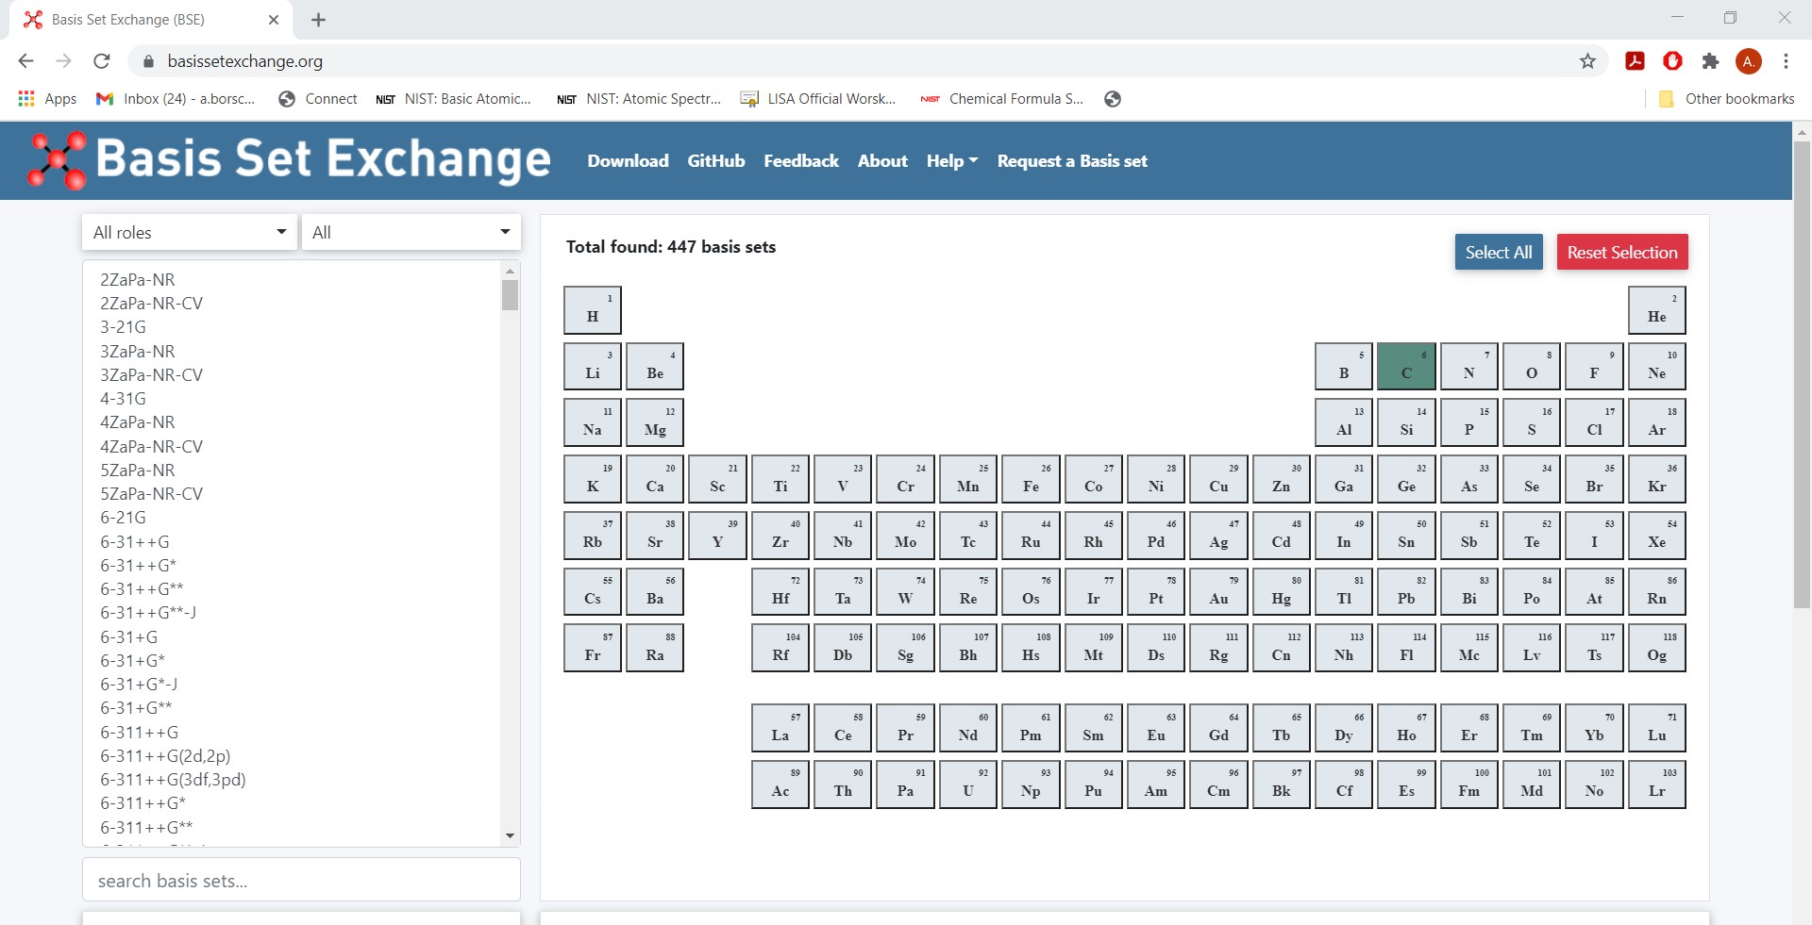
Basis sets
Shopping for a basis set:
Dyall’s relativistic basis sets*
(K.G. Dyall, Theor. Chem Acc. 2002, 2004, 2006, 2007, 2009, 2011,2012, etc.)

Slide 39
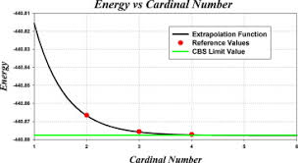
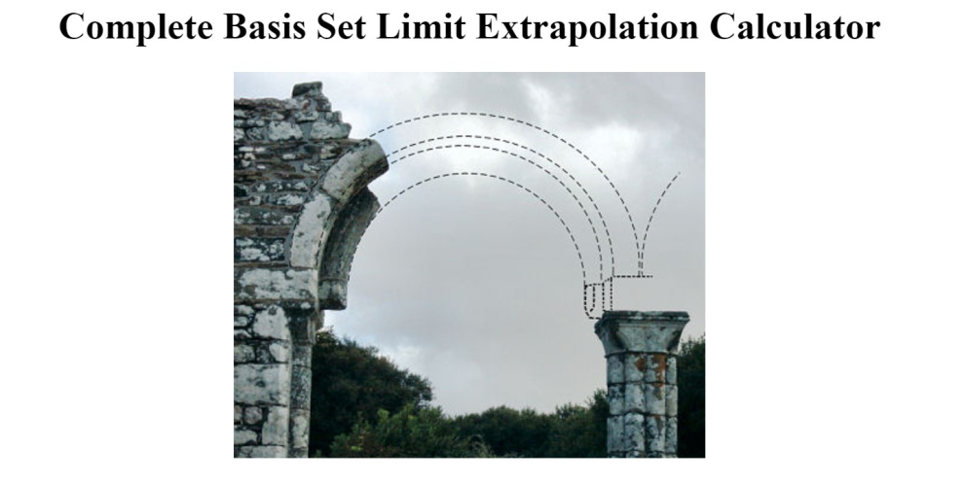
Basis sets
Reducing basis set error:
Extend basis set until convergence is reached (too expensive)
Complete basis set limit extrapolation
Perform calculations with progressively larger basis sets. Extrapolate to CBS limit:

Slide 40
Computational methods
Compromise between accuracy and computational costs
Choice of method will depend on the problem and the desired accuracy
Figure courtesy of P.Schwerdtfeger

