Slide 1
High‐accuracy electronic structure theory in support of spectroscopy
Anastasia Borschevsky
VSI, University of Groningen

Slide 2
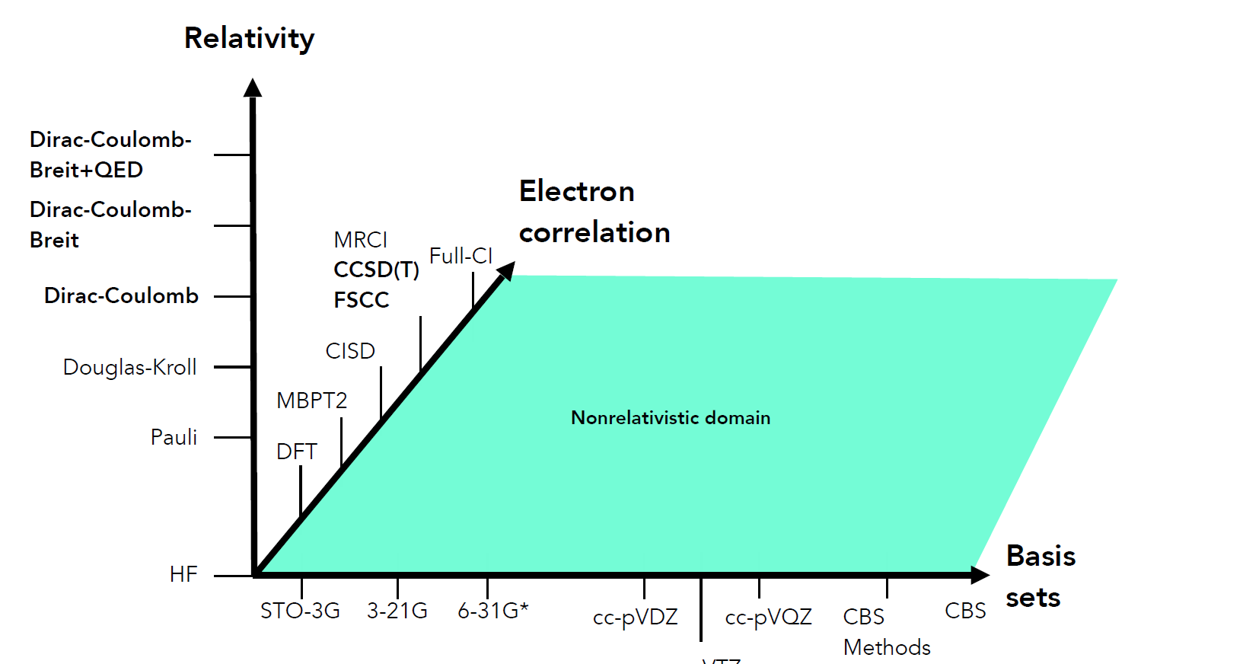
Computational methods
Compromise between accuracy and computational costs
Choice of method will depend on the problem and the desired accuracy
Figure courtesy of P.Schwerdtfeger

Slide 3
What do we want to calculate?
Atomic and molecular parameters ( energies, properties) needed in experiments
  (usually) heavy systems, hence relativistic methods
High accuracy
  State-of-the-art treatment of correlation, large basis sets
Uncertainty estimates
  Robust, transparent methods

Slide 4
Relativistic coupled cluster
Based on the 4c Dirac Hamiltonian
Accurate, size-extensive, and size-consistent
CCSD(T) - single reference coupled cluster
Closed shell systems/systems with one dominant configuration (good example: At⁻ [Rn, ¹S₀], BaF, X ²Σ)
FSCCSD – multireference Fock space coupled cluster
Open shell systems, excited states, bond dissociation (good example: ThO ³Δ₁ or any atomic spectrum)
Use the suitable method, or both in complementary manner.

Slide 5
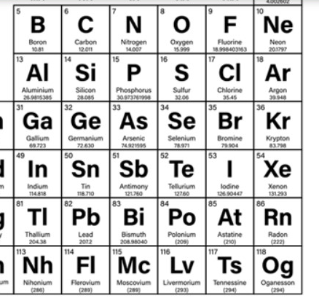
How do we assign uncertainties?
Calculate the same property in a homologue where experiment is available
Calculate a different property in the same atom, for which we have experiment
Perform a computational study to evaluate missing effects
?
?
?

Slide 6
Software
  Tel Aviv atomic computational package (TRAFS-3C)
Tel-Aviv Relativistic Atomic Fock-Space coupled cluster code, written by E.Eliav and U.Kaldor, with contributions from Y. Ishikawa, A. Landau, A. Borschevsky and H. Yakobi.
  DIRAC18 computational package
DIRAC, a relativistic ab initio electronic structure program, release DIRAC18 (2018)

Slide 7
What can we calculate?
Atomic properties: energies, IPs, EAs, spectra, hyperfine structure parameters, polarisabilities
Molecular properties: geometries, molecular parameters, electronic structure, Franck-Condon Factors (FCFs), transition strengths
Specific properties: coupling parameters describing the sensitivity of the atom/molecule to “new physics” effects (eEDM, parity violation, nuclear anapole moment, variation of fundamental constants, etc.)
CCSD(T), FSCC: applicable to different systems/states
Expected accuracy: ~10s of meV for energies, single % for properties
Systematic investigation of effect of computational parameters and uncertainty evaluation

Slide 8
What can we calculate?
Atomic properties: energies, IPs, EAs, spectra, hyperfine structure parameters, polarisabilities
Molecular properties: geometries, molecular parameters, electronic structure, Franck-Condon Factors (FCFs), transition strengths
Specific properties: coupling parameters describing the sensitivity of the atom/molecule to “new physics” effects (eEDM, parity violation, nuclear anapole moment, variation of fundamental constants, etc.)
CCSD(T), FSCC
Systematic investigation of effect of computational parameters and uncertainty evaluation
Any drawbacks?
  Computationally expensive (limited to atoms/small molecules)
  FSCC is limited to systems with up to two valence electrons/holes*
  Some properties not (yet) available
  *New developments in the group of Zaitsevskii: 3 particles

Slide 9

What can we calculate?
Atomic properties: energies, IPs, EAs, spectra, hyperfine structure parameters, polarisabilities
Molecular properties: geometries, molecular parameters, electronic structure, Franck-Condon Factors (FCFs), transition strengths
Specific properties: coupling parameters describing the sensitivity of the atom/molecule to “new physics” effects (eEDM, parity violation, nuclear anapole moment, variation of fundamental constants, etc.)
CCSD(T), FSCC
Systematic investigation of effect of computational parameters and uncertainty evaluation
Any drawbacks?
  Computationally expensive (limited to atoms/small molecules)
  FSCC is limited to systems with up to two valence electrons/holes
  Some properties not (yet) available

Slide 10
Applications
Towards heaviest elements: IP of lawrencium
Can we do better? Study on gold
Error estimation? Electron affinity of astatine
Properties: HFS in nobelium
Properties and error estimates: HFS in germanium
And something different: parity violation in chiral molecules
P. Pyykko, Chem. Rev. 88, 563 (1988)

Slide 11
Applications
Towards heaviest elements: IP of lawrencium
Can we do better? Study on gold
Error estimation? Electron affinity of astatine
Properties: HFS in nobelium
Properties and error estimates: HFS in germanium
And something different: parity violation in chiral molecules
P. Pyykko, Chem. Rev. 88, 563 (1988)

Slide 12

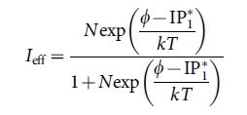
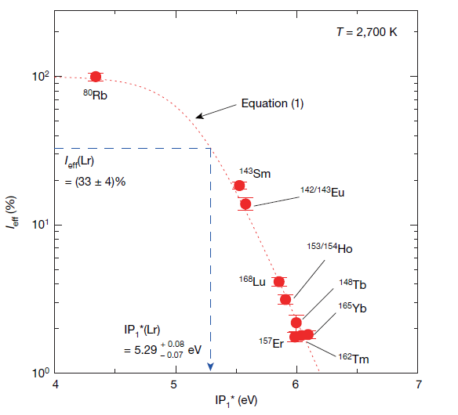

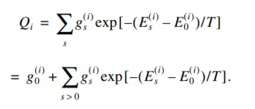
Ionization potential of Lr (Z=103)
Measurement using surface ionization technique
Lr
Q_{i} and Q₀: partition functions of the ion and the atom, calculated using excitation energies.

Slide 13
Ionization potential of Lr (Z=103)
Measurement using surface ionization technique
Lr

Slide 14
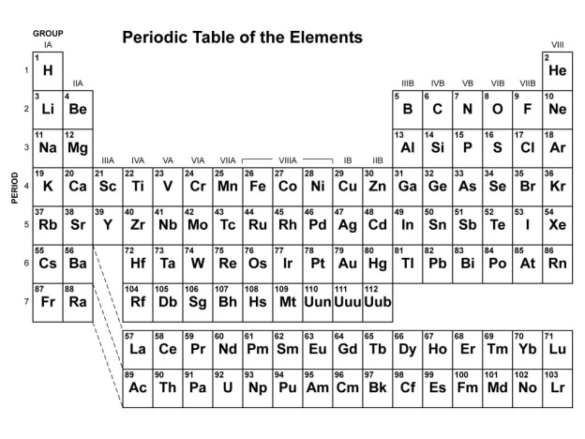
FSCC: spectra of Lu and Lr
[eV] |  | Lu (FSCC) | Lu (Exp.) | Lr (FSCC)
Ground state |  | 6s²5d ²D_{3/2} | 6s²5d ²D_{3/2} | 7s²7p_{1/2} ²P_{1/2}
IP |  | 5.311 | 5.425 | 4.893
ns²(n-1)d | ²D_{3/2} | - | - | 0.175
 | ²D_{5/2} | 0.241 | 0.247 | 0.630
ns²np | ²P_{1/2} | 0.506 | 0.513 | -
 | ²P_{3/2} | 0.916 | 0.927 | 1.040
ns(n+1)s | ²S_{1/2} | 2.944 | 2.991 | 2.496
ns²⁽n+1)p | ²P_{1/2} | 3.776 | 3.649 | 3.236
 | ²P_{3/2} | 3.835 | 3.780 | 3.408
ns²(n)d | ²D_{3/2} | 3.959 | 3.910 | 3.483
 | ²D_{5/2} | 3.972 | 3.932 | 3.518
ΔE |  | 0.020
A. Borschevsky, E. Eliav, Y. Ishikawa, M.J. Vilkas, and U. Kaldor, EPJD 45, 115 (2007)

Slide 15
CCSD(T): IPs of Lu and Lr
The experimental IP* and the FSCC excitation energies are used to obtain IP: independent prediction needed
eV | SRCCSD(T) | Exp.
Lu | 5.418 (-0.007) | 5.425
Lr | 4.963

Slide 16
CCSD(T): IPs of Lu and Lr
The experimental IP* and the FSCC excitation energies are used to obtain IP: independent prediction needed
eV | SRCCSD(T) | Exp.
Lu | 5.418 (-0.007) | 5.425
Lr | 4.963 | 4.96^{+0.08}_{-0.07}

Slide 17
Ground state of Lr
Ground state of Lr: 7s²6d ²D_{3/2} (like Lu) or 7s²7p ²P_{1/2} ?
FSCC (eV) | NR | 4c
 | Lu
²D_{3/2} | 0 | 0
²P_{1/2} | 1.608 | 0.506 (0.513)
 | Lr
²D_{3/2} | 0 | 0.175
²P_{1/2} | 2.310 | 0

Slide 18
Ground state of Lr
Ground state of Lr: 7s²6d ²D_{3/2} (like Lu) or 7s²7p ²P_{1/2} ?
CCSD(T) (eV) | NR | 4c
 | Lr
²D_{3/2} | 0 | 0.180
²P_{1/2} | 2.200 | 0
Both FSCC and SRCCSD(T) favour 7s²7p_{1/2} ²P_{1/2} (due to relativistic stabilization of 7p_{1/2} orbital). To be confirmed experimentally!

Slide 19

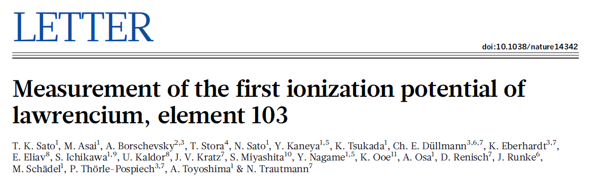
Ground state of Lr
Ground state of Lr: 7s²6d ²D_{3/2} (like Lu) or 7s²7p ²P_{1/2} ?
CCSD(T) (eV) | NR | 4c
 | Lr
²D_{3/2} | 0 | 0.180
²P_{1/2} | 2.200 | 0
Both FSCC and SRCCSD(T) favour 7s²7p_{1/2} ²P_{1/2} (due to relativistic stabilization of 7p_{1/2} orbital). To be confirmed experimentally!

Slide 20
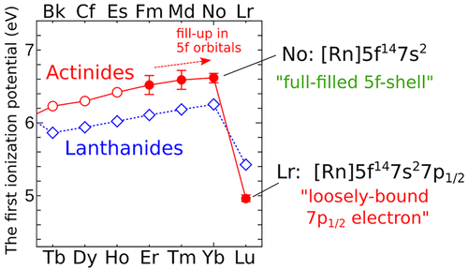
IPs of Fm (Z=100), Md (Z=101), and No (Z=102)
(eV) | Fm | Md | No*
CCSD(T) | 6.469 | 6.557 | 6.638
Exp. | 6.52±0.13 | 6.59±0.13 | 6.62±0.06
*For No, good agreement with previous measurement (6.626 eV) and with CI+all order
prediction of Dzuba et al. (4. 743 eV)

Slide 21
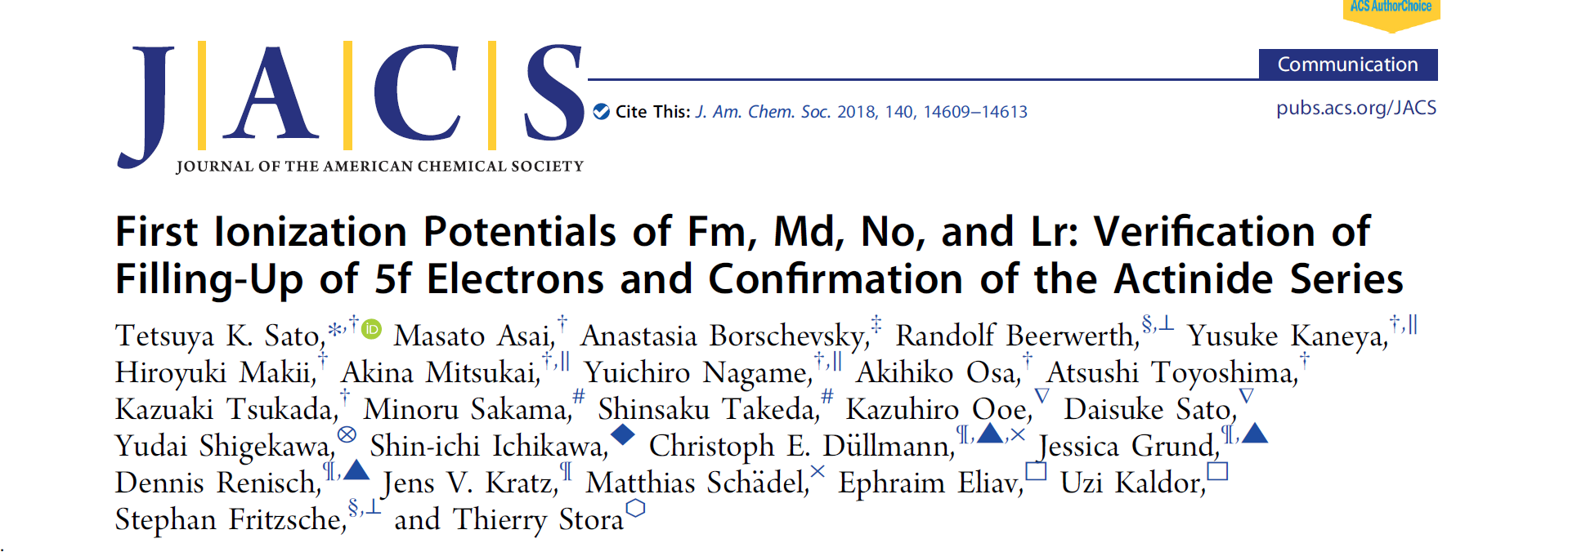
IPs of Fm (Z=100), Md (Z=101), and No (Z=102)
(eV) | Fm | Md | No*
CCSD(T) | 6.469 | 6.557 | 6.638
Exp. | 6.52±0.13 | 6.59±0.13 | 6.62±0.06
*For No, good agreement with previous measurement (6.626 eV) and with CI+all order
prediction of Dzuba et al. (4. 743 eV)

Slide 22
Applications
Towards heaviest elements: IP of lawrencium
Can we do better? Study on gold
Error estimation? Electron affinity of astatine
Properties: HFS in nobelium
Properties and error estimates: HFS in germanium
And something different: parity violation in chiral molecules
P. Pyykko, Chem. Rev. 88, 563 (1988)

Slide 23
Can we do better?
  Accuracy: ~10s of meV

Slide 24
Reaching meV accuracy: IP and EA of gold

Slide 25
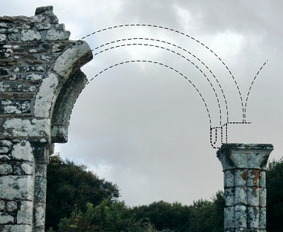
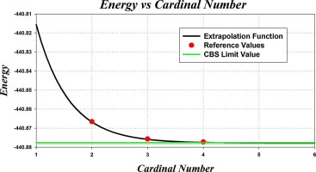
Reaching meV accuracy: IP and EA of gold
Complete basis set limit extrapolation

Slide 26
Reaching meV accuracy: IP and EA of gold
 | IP (eV) | ΔE (eV)
Hartree-Fock (NR) | 5.9864 | -3.2393
Dirac-Hartre-Fock | 7.6892 | -1.5365
DC-CCSD | 9.1163 | -0.10937
DC-CCSD(T) | 9.2937 | 0.0680
Golden standard
of computational
chemistry!
IP (exp.)=9.2256 eV

Slide 27
Reaching meV accuracy: IP and EA of gold

Slide 28
Reaching meV accuracy: IP and EA of gold
Correlation treatment
 | IP (eV) | ΔE (eV)
DC-CCSD(T) | 9.2937 | 0.0680
DC-CCSDT | 9.2640 | 0.0383
DC-CCSDTQ | 9.2695 | 0.0438
DC-CCSDTQP | 9.2697 | 0.0440
IP (exp.)=9.2256 eV

Slide 29
Reaching meV accuracy: IP and EA of gold

Slide 30
Reaching meV accuracy: IP and EA of gold
Treatment of relativity
Breit term:
QED: vacuum polarisation + self energy; model Lamb shift operator (MLSO) of Shabaev (Comput. Phys. Commun. 189, 175 (2015))
 | IP (eV) | ΔE (eV)
DC-CCSDTQP | 9.2697 | 0.0440
+Breit | 9.2541 | 0.0284
+QED (SE+VP) | 9.2288 | 0.0030

Slide 31
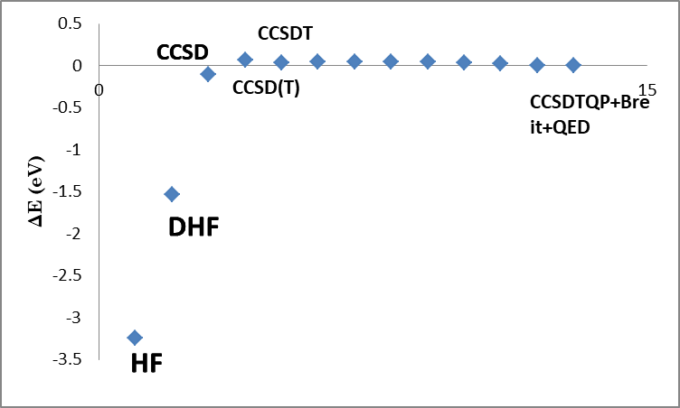
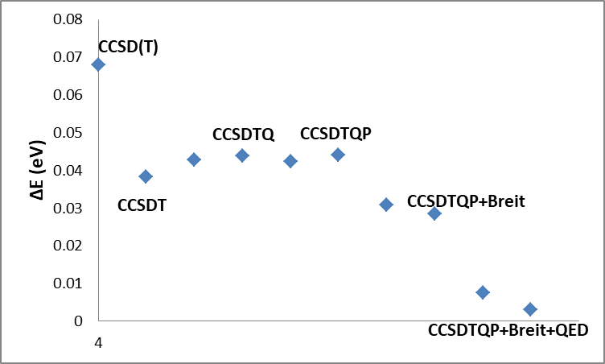
Reaching meV accuracy: IP and EA of gold
 | IP (eV) | ΔE (eV) | EA (eV) | ΔE (eV)
4c-CCSDTQP+Breit+QED | 9.2288 | 0.0030 | 2.3072 | 0.0014

Slide 32
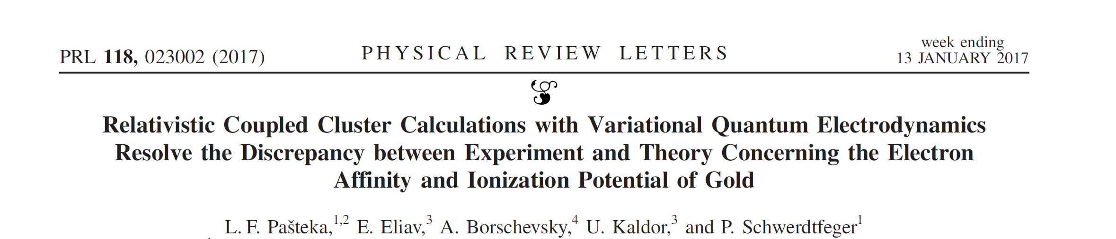
Reaching meV accuracy: IP and EA of gold
 | IP (eV) | ΔE (eV) | EA (eV) | ΔE (eV)
4c-CCSDTQP+Breit+QED | 9.2288 | 0.0030 | 2.3072 | 0.0014

Slide 33
Reaching meV accuracy: IP and EA of gold
Final results
IP (exp.)=9.2256 eV, EA (exp.)=2.3086 eV

Slide 34
Applications
Towards heaviest elements: IP of lawrencium
Can we do better? Study on gold
Error estimation? Electron affinity of astatine
Properties: HFS in nobelium
Properties and error estimates: HFS in germanium
And something different: parity violation in chiral molecules
P. Pyykko, Chem. Rev. 88, 563 (1988)

Slide 35
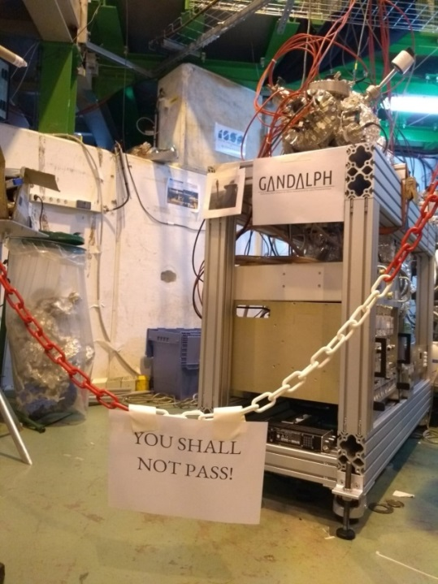

Electron affinity of At
One of the rarest of all naturally occurring elements
Knowledge of EA important for targeted alpha cancer therapy
Measurement at ISOLDE (CERN) by laser-photodetachment spectroscopy
Calculations before the experiment
Guide and confirmation for measurements

Slide 36
Electron affinity of At
(eV) | EA | I | At
“Golden Standard” | DC-CCSD(T) | 3.040 | 2.402
Higher order correlation effects | +ΔT | 0.004 | 0.003
 | +Δ(Q) | 0.004 | 0.004
Relativity | +Breit | 0.003 | 0.003
 | +QED (VP+SE)* | 0.003 | 0.003
 | Final | 3.055 | 2.414
 | Exp. | 3.059038(10)
*Model Lamb shift operator (MLSO) of Shabaev (Comput. Phys. Commun. 189, 175 (2015))

Slide 37
Electron affinity of At: uncertainty evaluation
?
?
?

Slide 38
Electron affinity of At: uncertainty evaluation
Higher order QED effects: smaller than vacuum polarization+self energy contributions
Higher excitations (full quadruples and higher): smaller than (Q)
Basis set: half the difference between CBSL and ae4z basis results
Source of uncertainty | I | At
Higher order QED | 0.003 | 0.003
Higher excitations | 0.004 | 0.004
Basis set | 0.014 | 0.015
Total (eV) | 0.015 | 0.016

Slide 39
Electron affinity of At
EA (eV) | I | At
CCSD | 2.961 | 2.309
+(T) | 0.079 | 0.092
+ΔT | 0.004 | 0.003
+Δ(Q) | 0.004 | 0.004
+Breit | 0.003 | 0.003
+QED | 0.003 | 0.003
Final | 3.055(15) | 2.414(16)
Exp. | 3.059038(10)

Slide 40
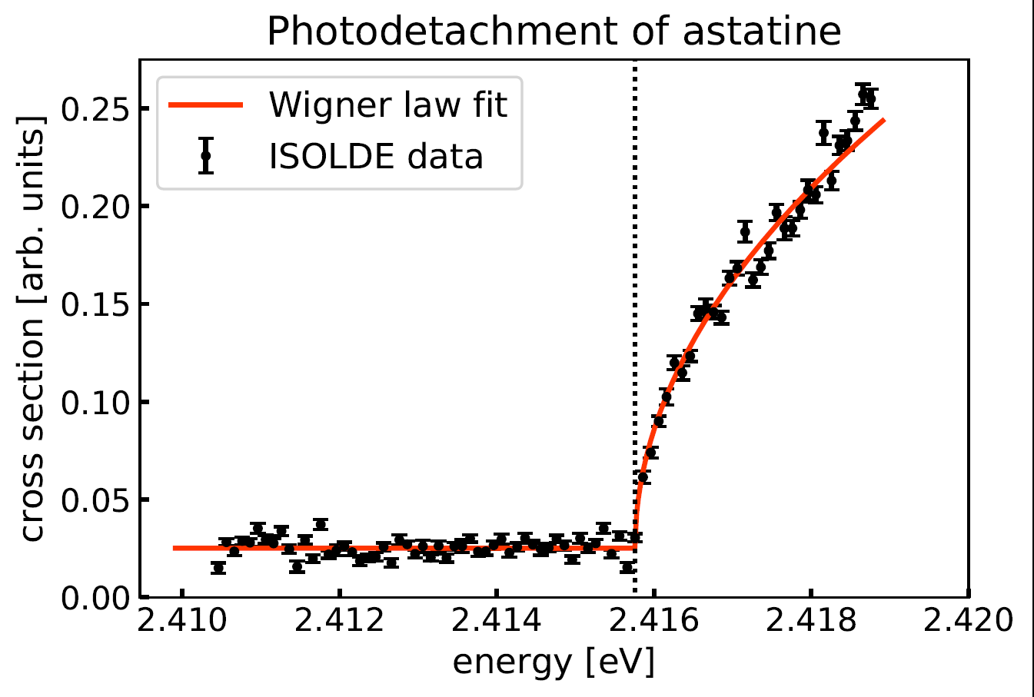
Electron affinity of At
EA (eV) | I | At
CCSD | 2.961 | 2.309
+(T) | 0.079 | 0.092
+ΔT | 0.004 | 0.003
+Δ(Q) | 0.004 | 0.004
+Breit | 0.003 | 0.003
+QED | 0.003 | 0.003
Final | 3.055(15) | 2.414(16)
Exp. | 3.059038(10) | 2.41579(5)

Slide 41
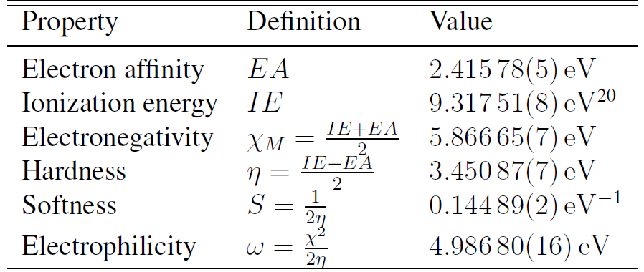
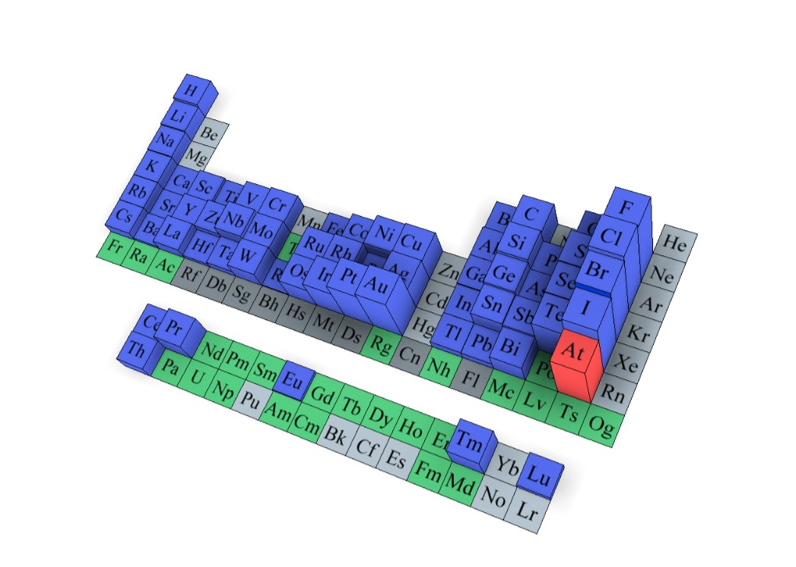

Lowest for halogens, highest
among the rest of the PT
Yangyang Guo

Slide 42
Lowest for halogens, highest
among the rest of the PT
See poster by Yangyang Guo
Yangyang Guo

Slide 43
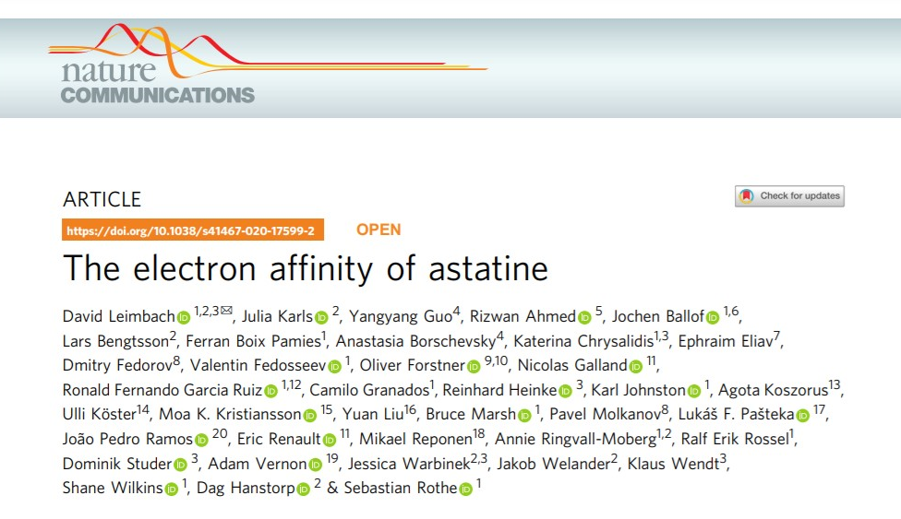
Lowest for halogens, highest
among the rest of the PT

Slide 44
EA of Po: see poster by Raphael Crosa-Rossa
Lowest for halogens, highest
among the rest of the PT

Slide 45
Applications
Towards heaviest elements: IP of lawrencium
Can we do better? Study on gold
Error estimation? Electron affinity of astatine
Properties: HFS in nobelium
Properties and error estimates: HFS in germanium
And something different: parity violation in chiral molecules
P. Pyykko, Chem. Rev. 88, 563 (1988)

Slide 46

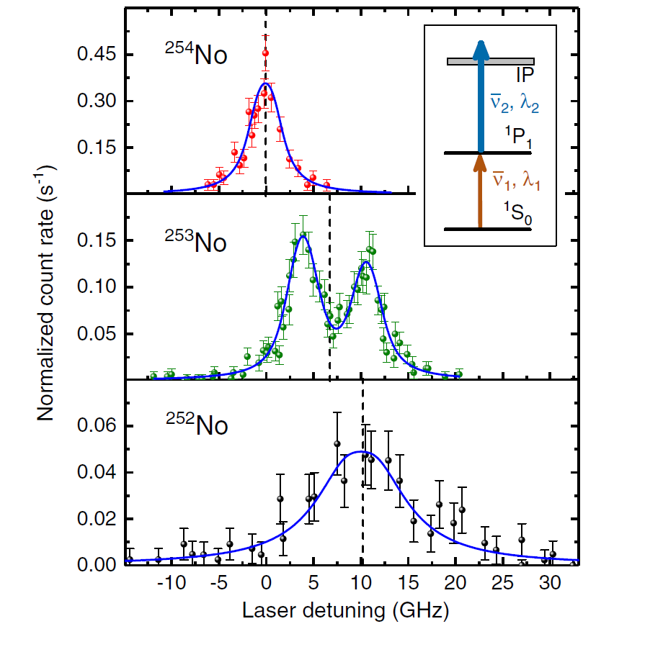
Nobelium (Z=102) hyperfine structure
Atom-at-a-time laser spectroscopy on ^{252,253,254}No
¹S₀ (7s²)→¹P₁ (7s6p) transition

Slide 47
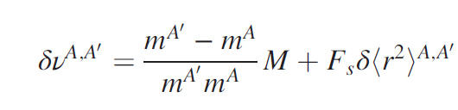
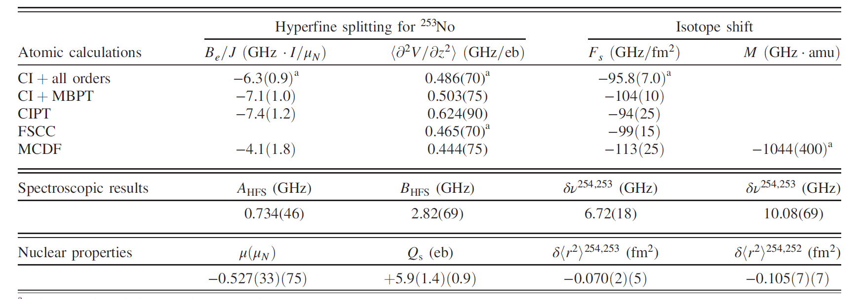
Nobelium hyperfine structure
A_{HFS}=μ(B_{e}/IJ)
B_{HFS}=eQ_{s}q
needed: field (F_{s}) and mass (M) shifts
B_{e}, q, F_{s} and M: depend on a given electronic state, provided by theory

Slide 48
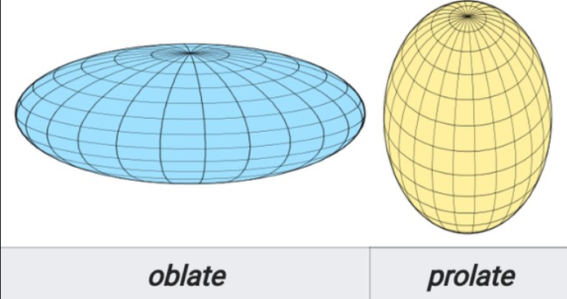
Nobelium hyperfine structure: nuclear moments
Method | q (GHz/eb)
CI+all orders | 0.486(70)
FSCC | 0.465(70)
MCDF | 0.444(75)
B_{HFS}=2.82(69) GHz (B_{HFS}=eQ_{s}q )
Q_{s}(²⁵³No)=+5.9(1.4)(0.9) eb
Prolate nucleus, in agreement with predictions and earlier indications*.
Also μ(²⁵³No)=-0.527(33)(75) μ_{N} extracted from measurements using theory input.
R.D. Herzberg et al., Nature 442, 896 (2006); R. D. Herzberg et al., Eur. Phys. J. A 42, 333 (2009);
P. Reiter et al., Phys. Rev. Lett. 95, 032501 (2005).

Slide 49
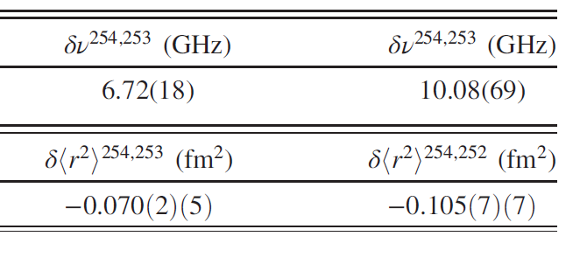
Nobelium hyperfine structure: isotope shifts
Method | F (GHz/fm²) | M (GHz*amu)
CI+all orders | -96(7)
FSCC | -99(15)
MCDF | -113(25)(75) | 1044(400)

Slide 50
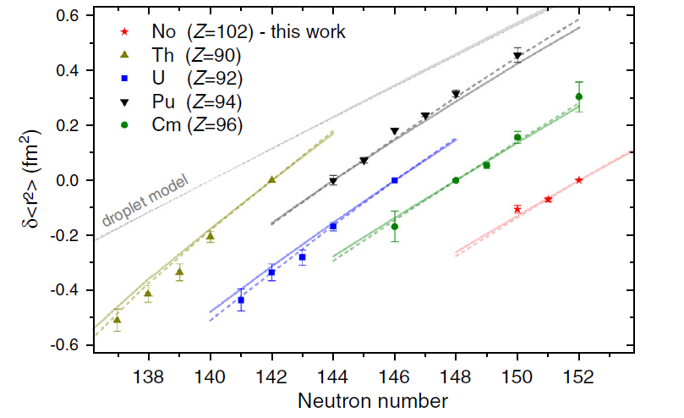
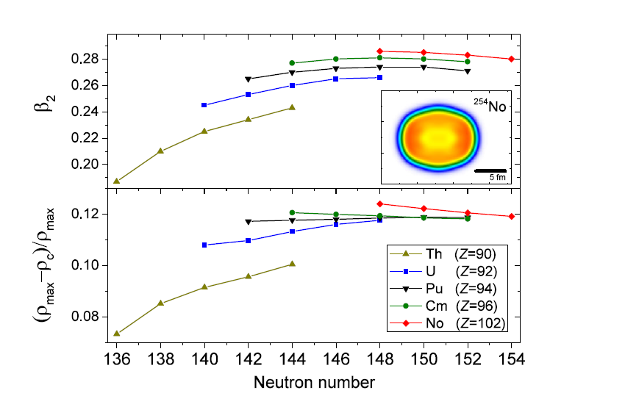
Nobelium hyperfine structure: isotope shifts
In agreement with DFT calculations (M. Kortelainen, et al, Phys. Rev. C 85, 024304 (2012); P. Klüpfel, et al., Phys. Rev. C 79, 034310 (2009))

Slide 51
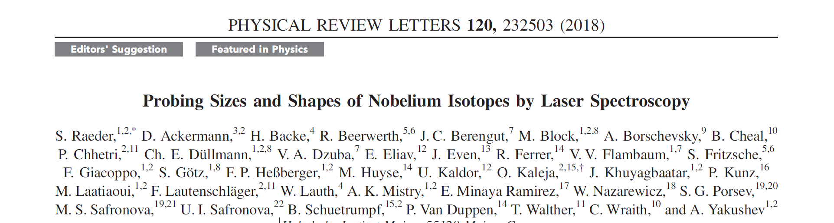
Nobelium hyperfine structure: isotope shifts
In agreement with DFT calculations (M. Kortelainen, et al, Phys. Rev. C 85, 024304 (2012); P. Klüpfel, et al., Phys. Rev. C 79, 034310 (2009))

Slide 52
Applications
Towards heaviest elements: IP of lawrencium
Can we do better? Study on gold
Error estimation? Electron affinity of astatine
Properties: HFS in nobelium
Properties and error estimates: HFS in germanium
And something different: parity violation in chiral molecules
P. Pyykko, Chem. Rev. 88, 563 (1988)

Slide 53
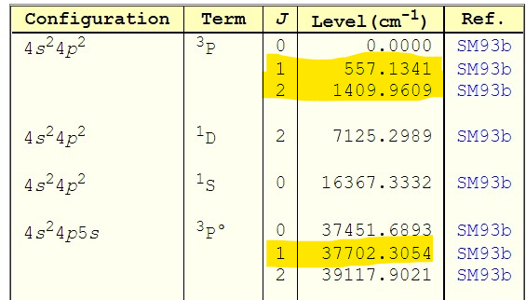
Germanium hyperfine parameters
Work carried out in collaboration with ISOLDE@CERN
q parameters, A₀ parameters (new implementations)
3 states:

Slide 54
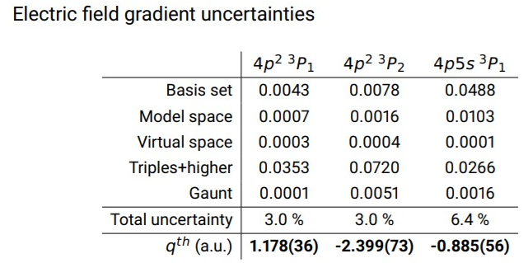
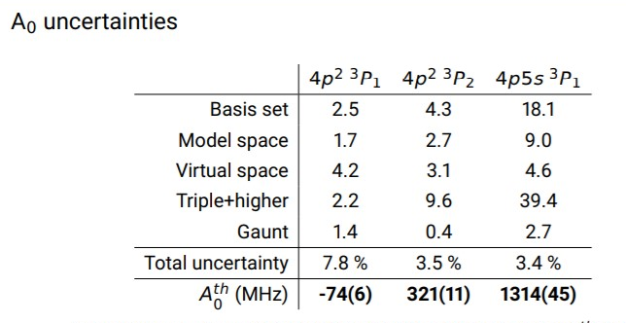
Germanium hyperfine parameters
Final values and uncertainty evaluation:

Slide 55
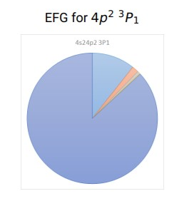
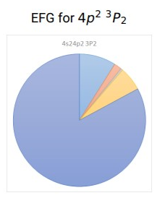
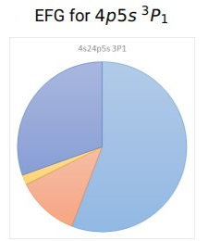
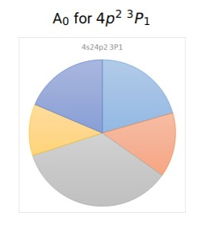
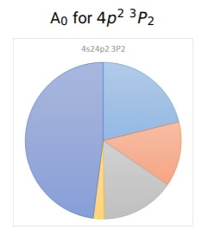
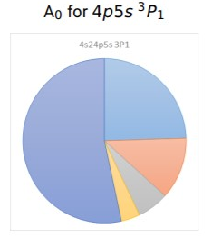

Germanium hyperfine parameters
Uncertainty analysis:

Slide 56
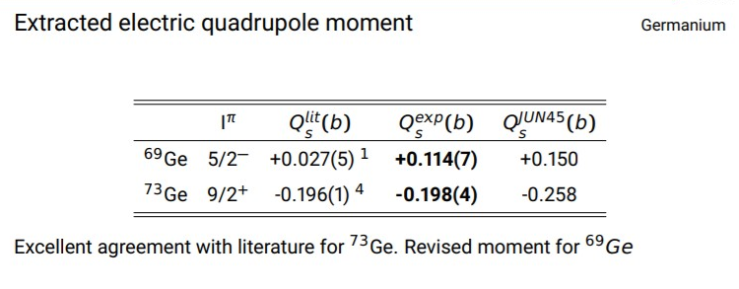
Germanium hyperfine parameters
The magnitude and the breakdown of uncertainty differ between
  Different properties
  Different states
We need to perform separate error evaluation for optimal reliability!

Slide 57
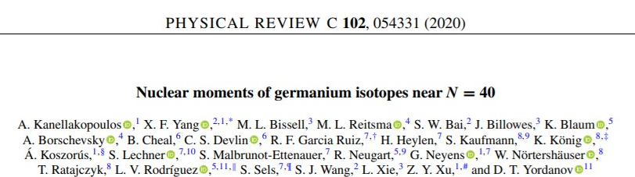
Germanium hyperfine parameters
The magnitude and the breakdown of uncertainty differ between
  Different properties
  Different states
We need to perform separate error evaluation for optimal reliability!
See poster by Martijn Reitsma

Slide 58
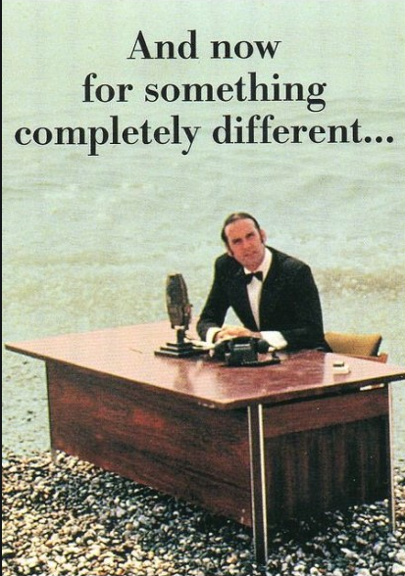

Slide 59
Applications
Towards heaviest elements: IP of lawrencium
Can we do better? Study on gold
Error estimation? Electron affinity of astatine
Properties: HFS in nobelium
Properties and error estimates: HFS in germanium
And something different: parity violation in chiral molecules
P. Pyykko, Chem. Rev. 88, 563 (1988)

Slide 60
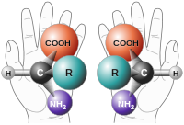
Is there a difference in the properties of the right- and the left handed enantiomers?
PV is firmly established in nuclear and atomic physics
In chiral molecules, the weak neutral current between the electrons and the nuclei is predicted to result in a tiny energy difference between the enantiomers.
If detected, this could help explain the origins of biohomochirality

Slide 61
Is there a difference in the properties of the right- and the left handed enantiomers?
So far, no detection!
The search continues: in electronic transitions, NMR spectroscopy, and in vibrational spectroscopy

Slide 62
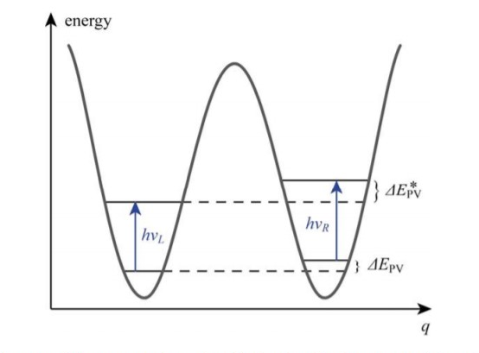
Search for parity violation in vibrational spectroscopy.
Measure hν_{L}-hν_{R}
Measurements performed at Laboratoirede Physique des Lasers (LPL), on the C-F stretch vibration in CHFClBr

Slide 63
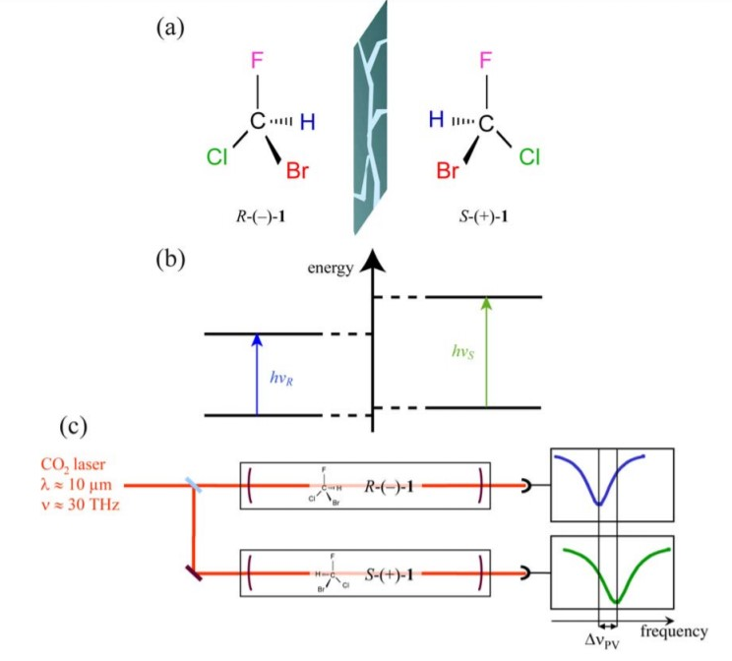


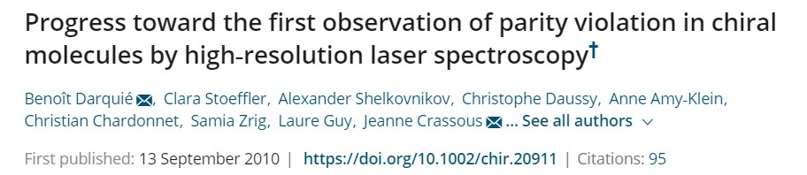
Search for parity violation in vibrational spectroscopy.
Measure hν_{S}-hν_{R}
Measurements performed at Laboratoirede Physique des Lasers (LPL), on the C-F stretch vibration in CHFClBr

Slide 64
Search for parity violation in vibrational spectroscopy.
Better candidate molecule needed!
Shopping list:
  Stable, commercially available
  Can be separated into pure enantiomers
  Can be brought into the gas phase
  Should contain heavy elements (absolute PV energy predicted to scale as Z⁵)
  Should have strong vibrational transitions in the range of the lasers (4-15 μm)
Relative effects of the order 10⁻¹⁵ can now be detected at LPL

Slide 65
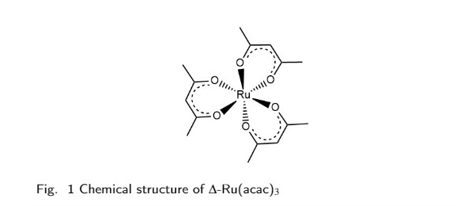
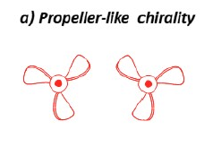
Search for parity violation in vibrational spectroscopy.
Better candidate molecule needed!
Shopping list:
  Stable, commercially available
  Can be separated into pure enantiomers
  Can be brought into the gas phase
  Should contain heavy elements (absolute PV energy predicted to scale as Z⁵)
  Should have strong vibrational transitions in the range of the lasers (4-15 μm)
Relative effects of the order 10⁻¹⁵ can now be detected at LPL

Slide 66
Search for parity violation in vibrational spectroscopy.
Better candidate molecule needed!
Shopping list:
  Stable, commercially available
  Can be separated into pure enantiomers
  Can be brought into the gas phase
  Should contain heavy elements (absolute PV energy predicted to scale as Z⁵)
  Should have strong vibrational transitions in the range of the lasers (4-15 μm)
Relative effects of the order 10⁻¹⁵?

Slide 67
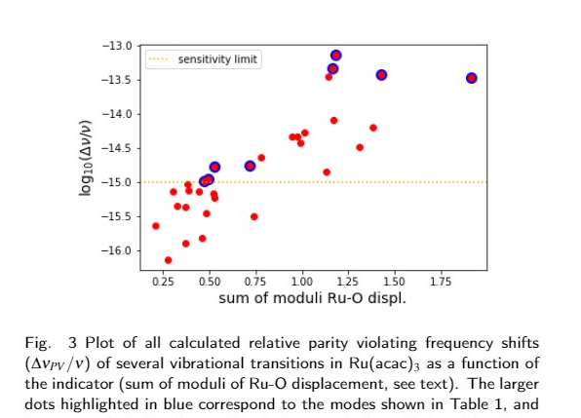
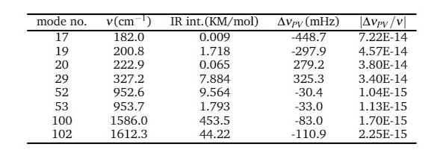
Search for parity violation in vibrational spectroscopy.
Better candidate molecule needed!
Relative effects of the order 10⁻¹⁵?
Relativistic calculations, DFT method

Slide 68
Search for parity violation in vibrational spectroscopy.
Better candidate molecule needed!
Relative effects of the order 10⁻¹⁵? Yes!
Relativistic calculations, DFT method

Slide 69
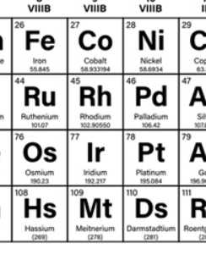
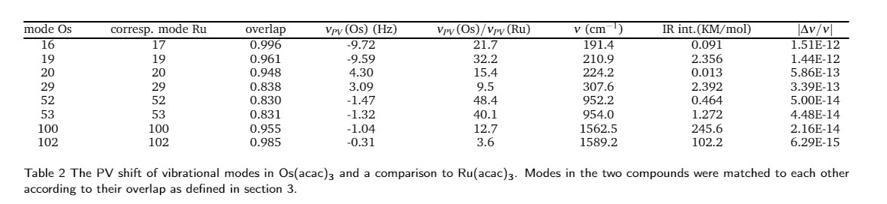


Search for parity violation in vibrational spectroscopy.
Better candidate molecule needed!
Relative effects of the order 10⁻¹⁵? Yes!
Relativistic calculations, DFT method
Even better: Os(acac)_{3,} effects of 10⁻¹³
Scaling better than Z⁵ predicted for total PV energies
Practical challenges to be solved

Slide 70

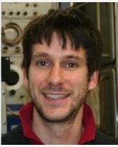



Search for parity violation in vibrational spectroscopy.
Better candidate molecule needed!
Relative effects of the order 10⁻¹⁵? Yes!
Relativistic calculations, DFT method
Even better: Os(acac)_{3,} effects of 10⁻¹³
Scaling better than Z⁵ predicted for total PV energies
Practical challenges to be solved
Preliminary results, MS in preparation
Marit Fiechter (now ETH Zurich)
Benoît Darquié, LPL
Jeanne Crassous, Rennes
Pi Haase
Lukas Pasteka, Bratislava

Slide 71
Conclusions and outlook
State of the art high accuracy computational approach
Versatile method: many possible applications (atoms, molecules, different states, different properties)
Reliable predictions and uncertainty estimates
Close collaborations with experimental groups
Uncertainties often limited by basis set: development of 5ξ basis sets in collaboration with Ken Dyall
Expanding FSCC applicability (Mass shifts, more complex systems)
Many exciting projects
Any computational requests?

Slide 72



Conclusions and outlook
Thank you for your attention! ☺
Lukas Pasteka
Ephraim Eliav

Slide 73





Uzi Kaldor
Ephraim Eliav
Miroslav Ilias
Julian Berengut

Slide 74

Why look for physics beyond the Standard Model (SM)?
The SM is currently the best fitting physical description of the world around us.
So far successfully explained the majority of observed natural phenomena and has strong predictive power (Higgs boson, top quark, tau neutrino)

Slide 75
Why look for physics beyond the Standard Model (SM)?
The SM is currently the best fitting physical description of the world around us.
So far successfully explained the majority of observed natural phenomena and has strong predictive power (Higgs boson, top quark, tau neutrino)
But… it is incomplete

Slide 76

Why look for physics beyond the Standard Model (SM)?
General relativity is not included
Some important questions remain unanswered:
  Matter-antimatter asymmetry
  Dark matter and energy

Slide 77
Why look for physics beyond the Standard Model (SM)?
Extensions to the SM attempt to fill these knowledge gaps.
  Grand Unified Theories, String Theory, SUSY, …
These extensions predict new physical phenomena beyond the SM.
  Variation of fundamental constants (VFC)
  Violation of fundamental symmetries (CP, P, T)
(non) discovery of these phenomena allows to discriminate between extensions or new theories.

Slide 78


Why look for physics beyond the SM with atoms and molecules?
Accelerator research (LHCb, T2K, etc.)
Table-top experiments

Slide 79

Why look for physics beyond the SM with atoms and molecules?
Table-top experiments: promising alternative to high energy research
  Versatile, sensitive to different phenomena
    Parity violation
    EDMs (electron, hadronic)
    Variation of fundamental constants
    Dark matter
    ..
  Various enhancement effects→ high sensitivity
  Small scale
  (Relatively) inexpensive

Slide 80
How can (atomic and molecular) theory be of use?
Insight into effect on molecular properties
Identification of promising candidates for measurements
  High sensitivity
  Experimental considerations (stability, laser-coolability, etc.)
Practical parameters for experiment
Parameters for the interpretation of the results

Slide 81
How can (atomic and molecular) theory be of use?
Insight into effect on molecular properties
Identification of promising candidates for measurements
  High sensitivity
  Experimental considerations (stability, laser-coolability, etc.)
Practical parameters for experiment
Parameters for the interpretation of the results
To be useful:
  Reliable predictions based on high accuracy calculations
  Preference for ab initio methods (predictive power)
  Possibility of assigning uncertainties
  Choice of computational method becomes crucial

Slide 82



Slide 83


Electron EDM

Slide 84


Electron EDM
Standard Model prediction: ~10⁻³⁸ e*cm
SM extensions predict much larger values (many orders of magnitude)
Measurement will provide signal of new physics
How do we measure eEDM?
Use a (paramagnetic) molecule!

Slide 85


Electron EDM
Standard Model prediction: ~10⁻³⁸ e*cm
SM extensions predict much larger values
Measurement will provide signal of new physics
Use a molecule!
YbF, ThO, HfF⁺,…
Upper limit 10⁻²⁹ e*cm, with ThO*
… and BaF
  Experimental advantages (laser cooling, Stark deceleration)

Slide 86



The experiment:
The EDM signal is detectable through a difference in the total accumulated phase for the parallel and the antiparallel orientation of the external magnetic and the electric fields.

Slide 87

The experiment:
The EDM signal is detectable through a difference in the total accumulated phase for the parallel and the antiparallel orientation of the external magnetic and the electric fields.

Slide 88
The experiment:
The EDM signal is detectable through a difference in the total accumulated phase for the parallel and the antiparallel orientation of the external magnetic and the electric fields.
E_{eff}=2W_{d}

Slide 89


Laser cooling:
Using light to slow transverse motion of the molecules
We need to identify the optimal cooling scheme (transition):
  Short lifetime (efficient cooling)
  Diagonal Frank-Condon factors (FCFs), to avoid leaks
Needed: potential energy curves, spectroscopic constants, FCFs, transition dipole moments, etc.

Slide 90

Laser cooling:
Relativistic FSCC calculations for the 6 lowest electronic states of CaF, SrF, and BaF

Slide 91

Laser cooling:
Two possible cooling schemes:
X ²Σ_{1/2}→ B ²Σ_{1/2} (CaF)
X ²Σ_{1/2} → A ²Π_{1/2} (CaF and SrF)
Use calculated FCFs (measure of overlap of vibrational wavefunctions) to determine the appropriate scheme
Diagonal FCFs→ efficient cooling

Slide 92

Laser cooling:
Two possible cooling schemes:
X ²Σ_{1/2}→ B ²Σ_{1/2} (CaF)?
Diagonal FCFs→ efficient cooling

Slide 93
Laser cooling:
Two possible cooling schemes:
X ²Σ_{1/2}→ B ²Σ_{1/2} (CaF)?
Nope ☹
Diagonal FCFs→ efficient cooling

Slide 94

Laser cooling:
Two possible cooling schemes:
X ²Σ_{1/2} → A ²Π_{1/2} (CaF and SrF)?
Diagonal FCFs→ efficient cooling

Slide 95
Laser cooling:
Two possible cooling schemes:
X ²Σ_{1/2} → A ²Π_{1/2} (CaF and SrF)?
Yes! ☺
Diagonal FCFs→ efficient cooling

Slide 96




Cooling scheme:
Yongliang Hao

Slide 97

Cooling scheme:
Yongliang Hao

Slide 98


Interpreting the experiment
d_{e}- electron EDM, κ_{s} - S-PS electron-nucleon interaction
W_{d}, W_{s}- molecule (and state) specific enhancement factors; depend on electronic structure and must come from theory.

Slide 99


Interpreting the experiment
d_{e}- electron EDM, κ_{s} - S-PS electron-nucleon interaction
Investigations of optimal combinations of molecules:
K. Gaul, S. Marquardt, T. Isaev, and R. Berger, Phys. Rev. A 99, 032509 (2019)
A . Sunaga, M. Abe, V. S. Prasannaa, T. vAoki, and M. Hada, J. Phys. B 53, 015102 (2019)

Slide 100




Interpreting the experiment
Use relativistic CCSD(T) to calculate W_{d} and W_{s}.
Systematically improve the calculation up to convergence
Perform an extensive computational study to estimate uncertainties
W_{d}
κ_{s}
κ_{s}

Slide 101

Interpreting the experiment
Use relativistic CCSD(T) to calculate W_{d} and W_{s}.
Systematically improve the calculation up to convergence

Slide 102



Interpreting the experiment
Use relativistic CCSD(T) to calculate W_{d} and W_{s} in BaF
Systematically improve the calculation up to convergence
Perform an extensive computational study to estimate uncertainties

Slide 103




Interpreting the experiment
Final recommended values:
Pi Haase, MS in preparation

Slide 104


Interpreting the experiment
Is the uncertainty estimate realistic?
Use a similar property, where comparison to experiment is possible, as a sanity check
Magnetic hyperfine structure constants

Slide 105

Interpreting the experiment
Is the uncertainty estimate realistic?
Use a similar property, where comparison to experiment is possible, as a sanity check
Magnetic hyperfine structure constants

Slide 106
Conclusions
Combination of methods is highly suitable to small heavy systems; high accuracy and strong predictive power
Versatile: different types of systems, different properties (IPs, EAs, transition energies, polarizabilities, hyperfine structure parameters, various coupling constants…)
We can provide meaningful predictions, which can be directly used to plan/interpret experiments or to compare to measurement results
We can also learn something about systems where no experiments are (yet) possible

Slide 107
Conclusions
We successfully use these methods in other problems and research topics (both in support of experiment and for purely theoretical research):
Investigations of highly charged ions
Search for variation of fundamental constants with atoms and molecules
Search for parity violation in molecules
And …

Slide 108

…eEDM in molecules
Both support of the experiment and theoretical investigations

Slide 109






Yongliang Hao
Pi Haase
Yangyang Guo
Hallo Arbely
Janna de Wit
Diewertje Doeglas

Slide 110


Uzi Kaldor
Ephraim Eliav
Peter Schwerdtfeger
Miroslav Ilias
Lukas Pasteka
Julian Berengut

Slide 111
Thank you for your attention!
Uzi Kaldor
Ephraim Eliav
Peter Schwerdtfeger
Miroslav Ilias
Lukas Pasteka
Julian Berengut

