Slide 1
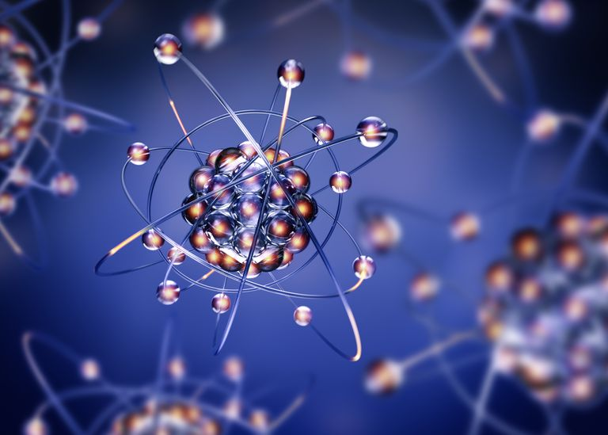
Internal-conversion electron spectroscopy
Lecture 1:
Historical overview
Properties of Internal Conversion
Experimental Techniques
Lecture 2:
Fine structure α spectroscopy
Isomer-decay tagging
Lifetime measurements
A. Lopez-Martens
(IJCLab)
Ecole Joliot Curie, 3-8 october 2021, St Pierre d’Oléron

Slide 2


Some good books

Slide 3
A litte step back in time….

Slide 4
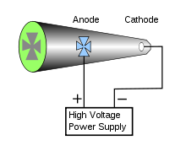
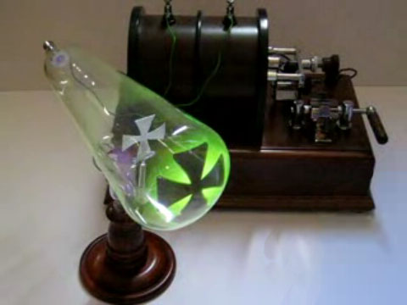
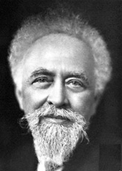
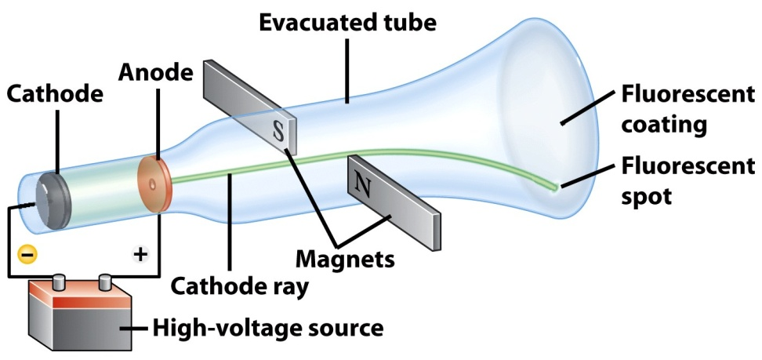
The Crookes tube & Cathode rays
1895: Jean Perrin demonstrates that cathode rays are negatively charged particles

Slide 5
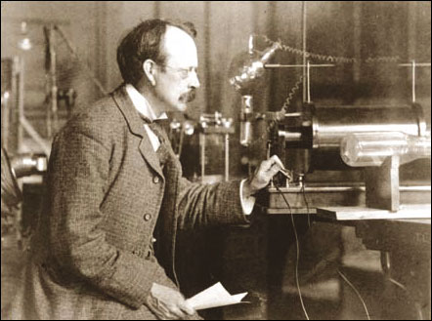
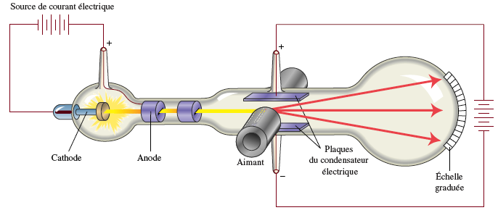
Corpuscules
Power supply
Electric
capacitor
plates
Magnet
Scale
John Joseph Thomson
1897: J.J. Thomson measures the charge/mass ratio of the charged particles
1898: J.J. Thomson concludes that these ‘corpuscules’ (= electrons) are the constituents of atoms

Slide 6
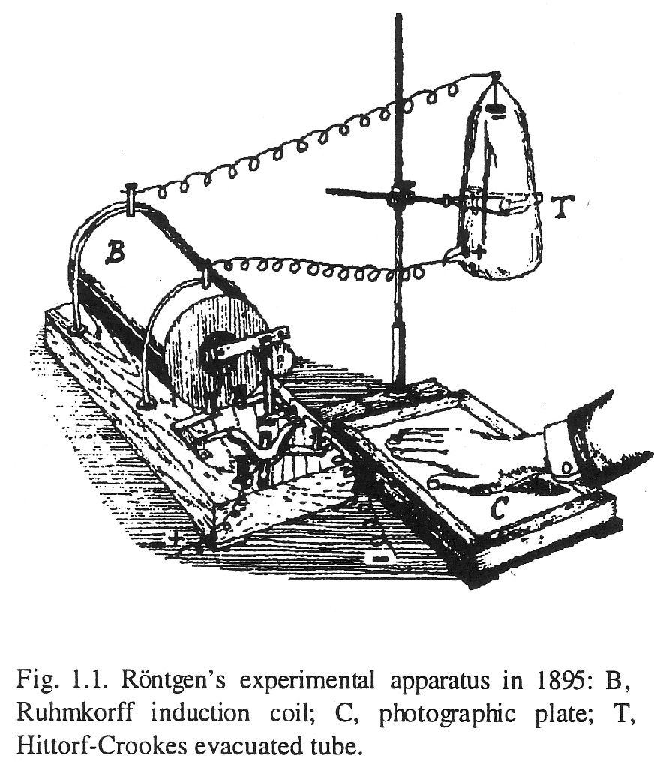
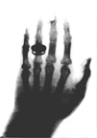
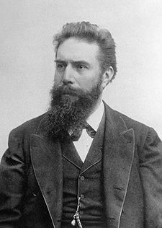

From cathode rays to X rays
1895 discovery of X rays
Wilhelm Röntgen
W. Röntgen receives the 1st Nobel Prize in Physics in 1901

Slide 7
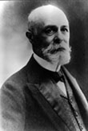
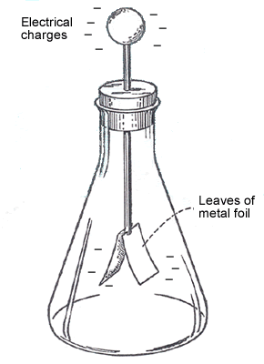
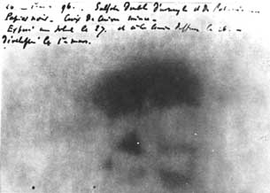
Discovery of radioactivity (1896-1898)
metal screen
with cut-out
design
uranium salts
photographic plate
Uranium rays ionize the air
and cause the discharge of
an electroscope
Henri Becquerel

Slide 8

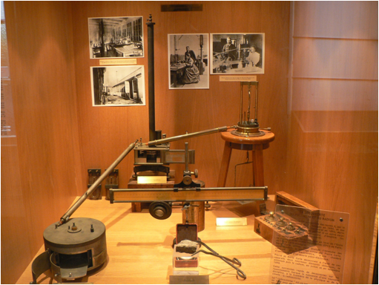
Discovery of radioactivity (1896-1898)
: Marie Curie discovers that Thorium also emits Becquerel’s rays
piezoelectric quartz
electrometer
Marie Sklodowska Curie
ionization chamber
Notes aux Comptes Rendus de l’Académie des Sciences , April 1898
Amount of activity is proportional to the number of atoms in the sample: atomic process

Slide 9
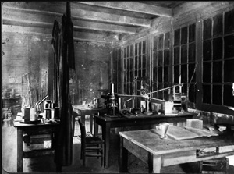
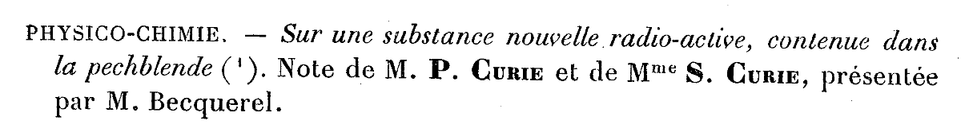
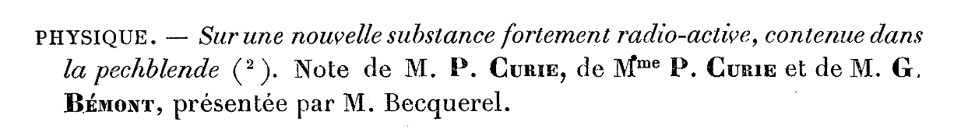
Discovery of radioactivity (1896-1898)
1898: Pechblende is more « active » than Uranium
Extraction of polonium (Bi fraction)
Notes aux Comptes Rendus de l’Académie des Sciences , July 1898
Extraction of radium (Ba fraction)
Notes aux Comptes Rendus de l’Académie des Sciences , December 1898
PhD & 1st Nobel Prize (Physics) in 1903
2nd Nobel Prize (Chemistry) in 1911
Laboratory at the Ecole de Physique et Chimie industrielle de Paris

Slide 10
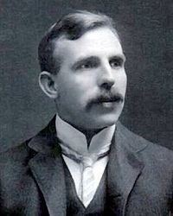

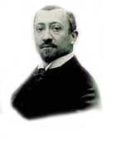
Different radioactivities
1898 E. Rutherfod alpha, beta radiation
1900 P. Villard gamma radiation
α
N
γ
S
Ernest Rutherford
radioactive
source
β
Paper
Aluminium
Concrete
α = hélium ion He²⁺
= high energy cathode rays (e-)
γ= photons - like X rays
Paul Villard

Slide 11
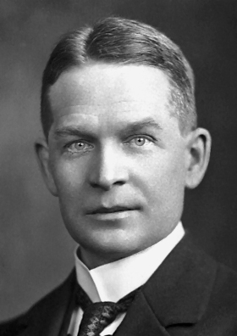
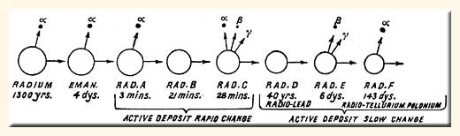
Transmutations through radioactivity
E. Rutherford & F. Soddy transmutation of atoms
²³⁸U
²³⁴U
²³⁴Pa
²³⁴Th
²³⁰Th
Frederick Soddy
Philosophical Transactions of the Royal Society of London, 1905
²²⁶Ra
β, γ
radioactivity
²²²Rn
²¹⁴Po
²¹⁰Po
α radioactivity
²¹⁸Po
²¹⁴Bi
²¹⁰Bi
Stable
²⁰⁶Pb
The rate of transmutation follows an exponential law
²¹⁴Pb
²¹⁰Pb
Notes:
Radium emanation - radon-222
Radium A - polonium-218
Radium B - lead-214
Radium C - bismuth-214
Radium C₁ - polonium-214
Radium C₂ - thallium-210
Radium D - lead-210
Radium E - bismuth-210
Radium F - polonium 210

Slide 12
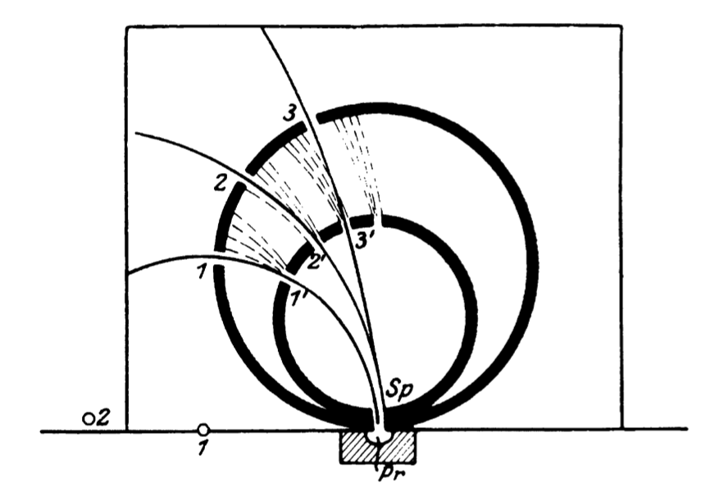
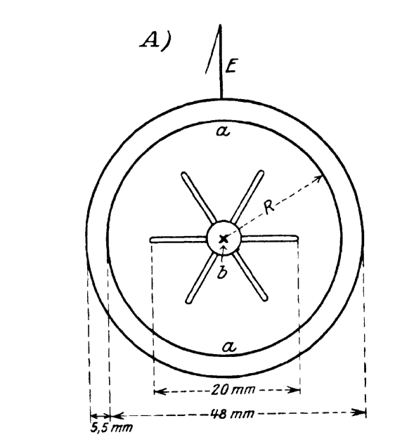
First measurements of the spetrum of beta rays
Inhomogeneity of the velocity distribution of beta rays from a Radium source
.
H. Becquerel C.R. 132 (1901), 1286-1288
Similar conclusion drawn from an experiment by F. Paschen
Ann. d. Phys. 14 (1904), 389-405

Slide 13

Absorption measurements
Intensity of monoenergetic beta rays after passing through a thickness d of matter was thought to follow an exponential law: I= I₀ e^{-λd}
=> « Beta rays from Ac are homogeneous in character »
T. Godlewski Phil. Mag. 10 (1905), 375-379, p. 377
Each pure element emits a single group of monoenergetic beta rays. In the case of complex sources, consisting of several elements, the absorption curves consisted of several superposed exponentials.
O. Hahn and L. Meitner, Phys. Zeit. 10 (1909), 741-745, p. 745
Lise Meitner

Slide 14
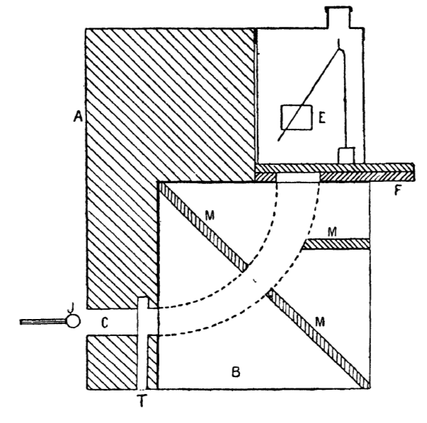
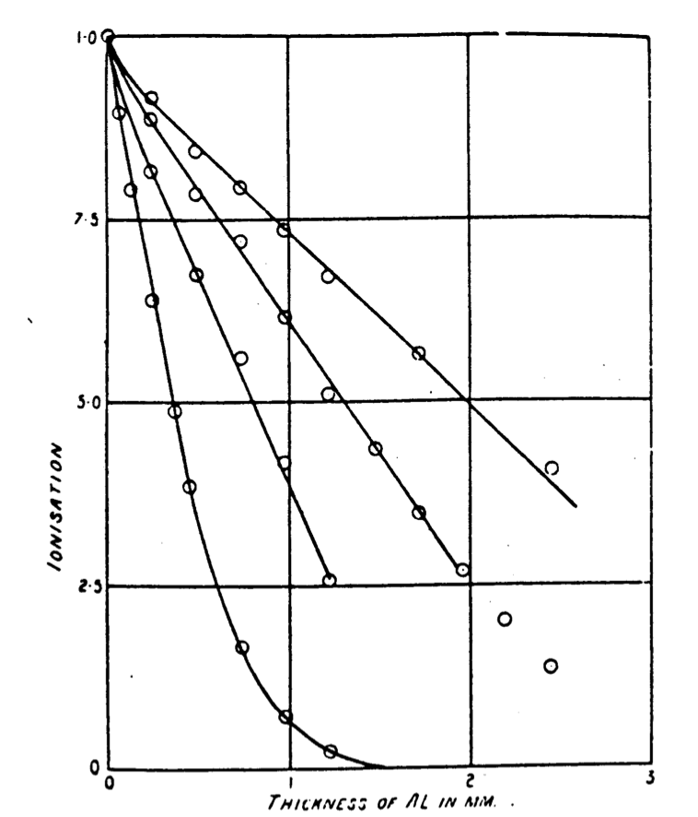
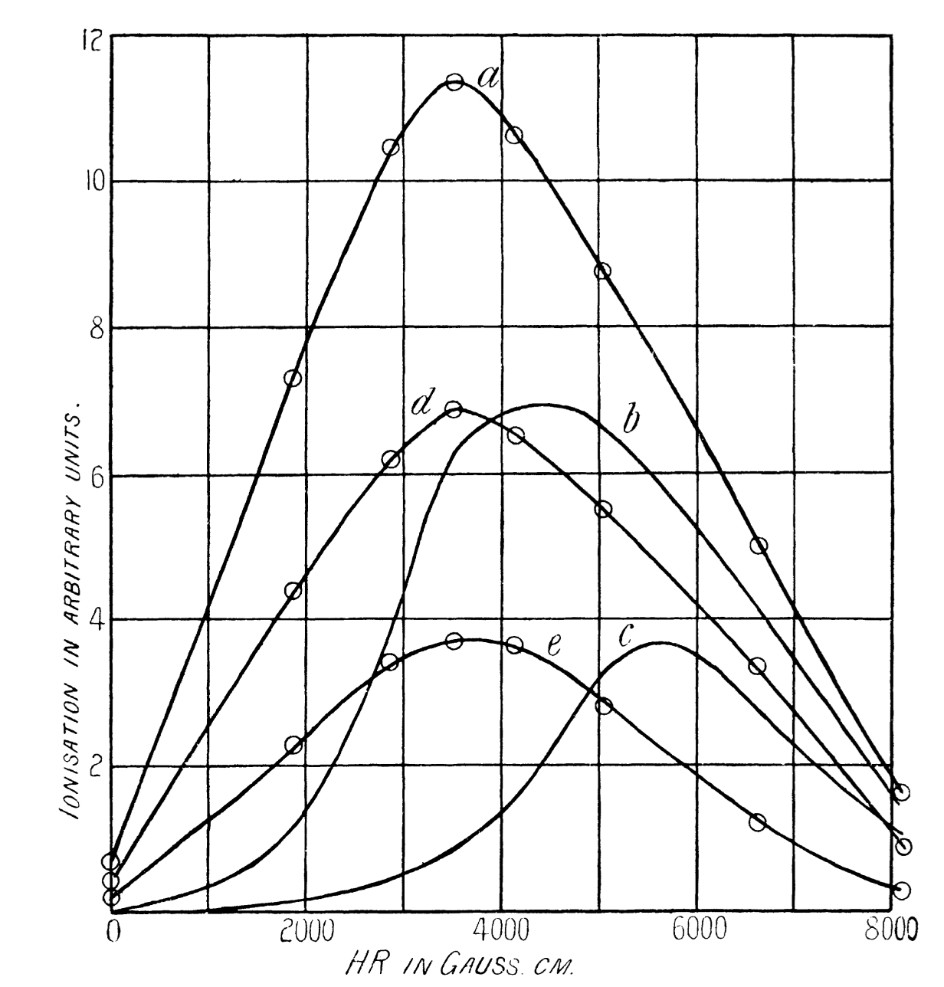
The Meitner-Wilson controversy
velocity loss of beta rays as they pass through matter
~linear absorption curve
W. Wilson, Proc. Roy. Soc. A82 (1909), 612-628

Slide 15
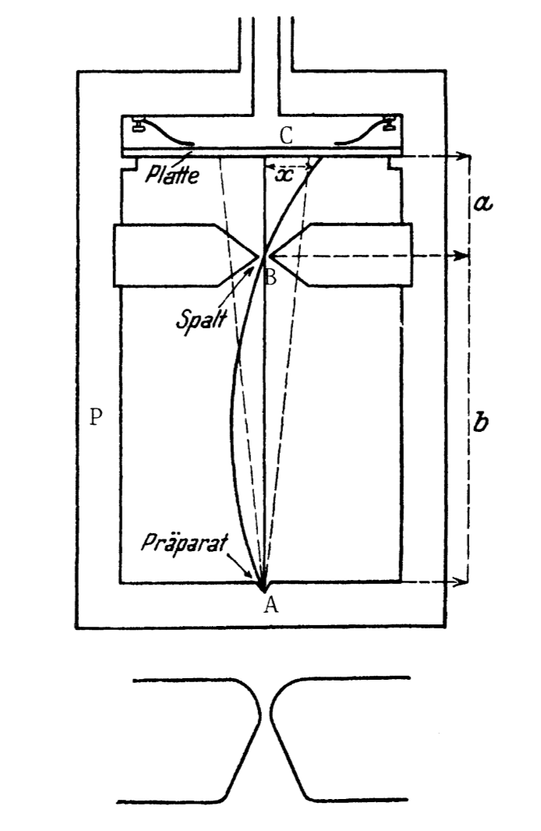
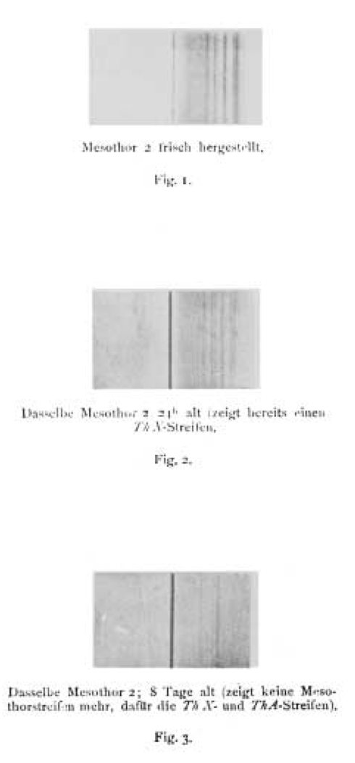
Consensus…
Complex beta-line spectrum with soft and swift rays (except for RadE [= ²¹⁰Bi] ?)
O. v. Baeyer, O. Hahn and L. Meitner, "Magnetische Spektren der Beta-Strahlen des Radiums," Phys. Zeit. 12 (1911) 1099-1101
O. v. Baeyer and O. Hahn, "Magnetische Linienspektren von Beta-Strahlen," Phys. Zeit. 11 (1910), 488-493

Slide 16
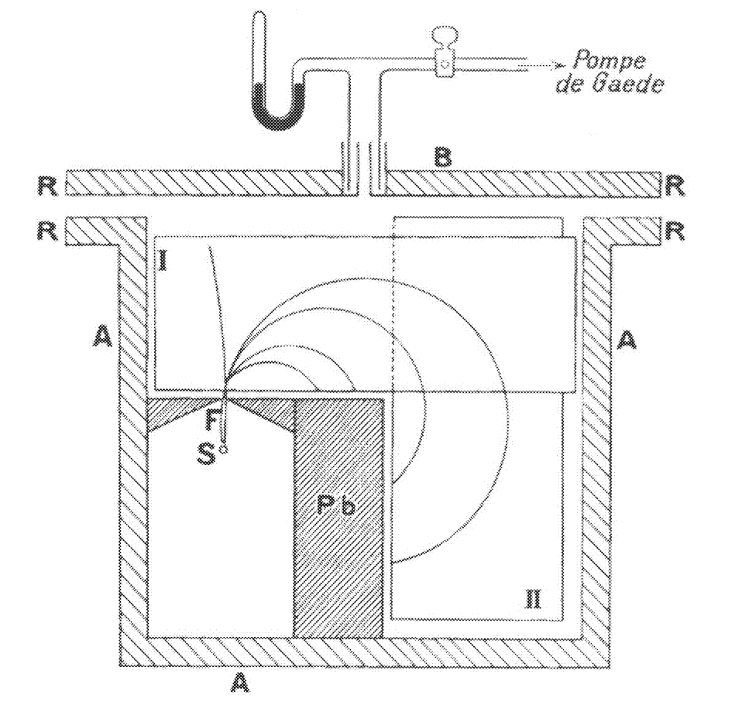
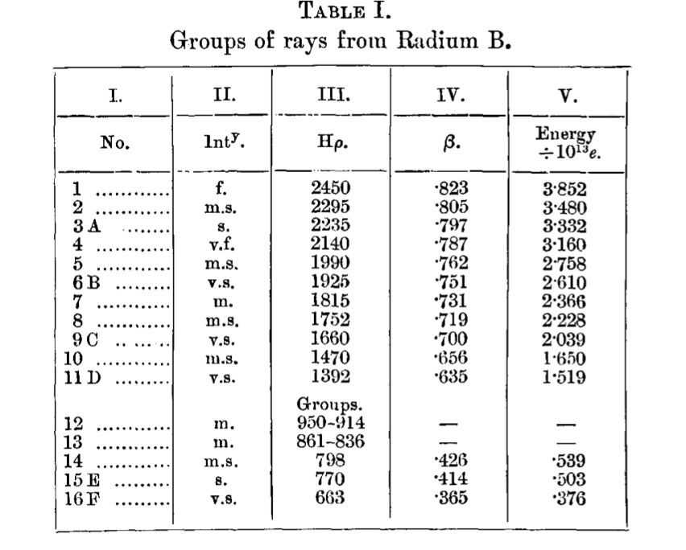
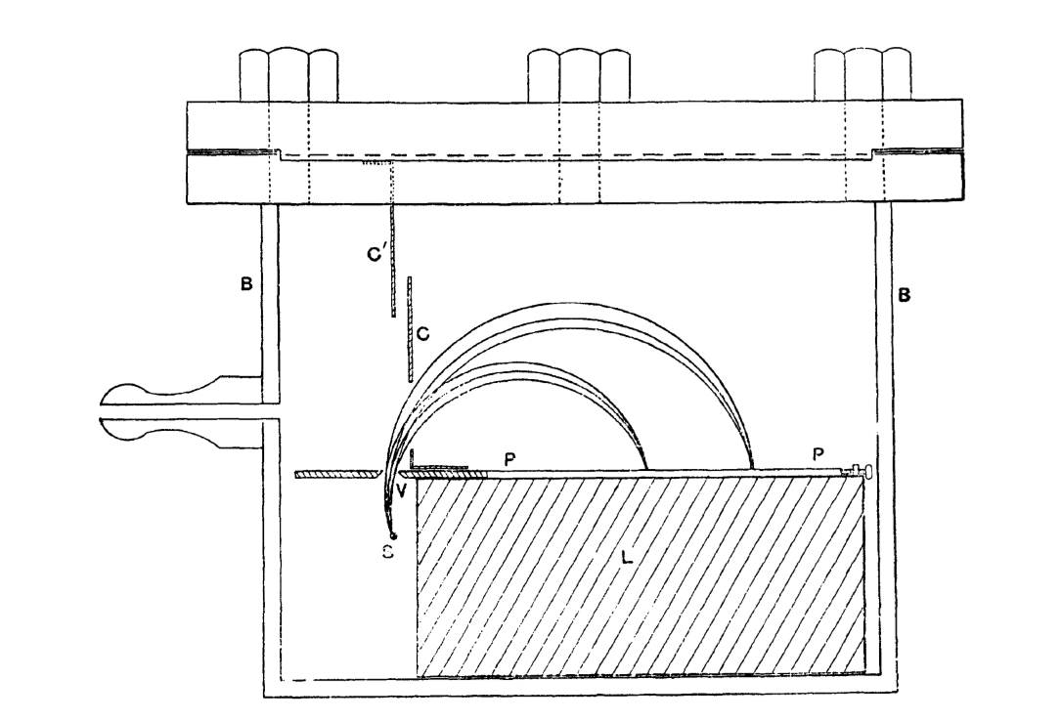
More lines resolved with a new experimental technique
[=²¹⁴Pb]
J. Danysz,
1913 (Paris)
E. Rutherford, H. Robinson, 1913 (Manchester)
E. Rutherford and H. Robinson, "The Analysis of the beta Rays from Radium B and Radium C," Phil. Mag. 26 (1913), 717-729.

Slide 17
Origin of the beta rays ?
« There appears to me no doubt that the alpha particle does arise from the nucleus, and I have thought for some time that the evidence points to the conclusion that beta particles have similar origin. (..) The strongest evidence in support of this view is, to my mind, (1) that the beta ray, like the alpha ray, transformations are independent of physical and chemical conditions, and (2) that the energy emitted in the form of beta and gamma rays is much greater than could be expected to be stored up in the external electronic system. At the same time I think it very likely that a considerable fraction of the beta rays which are expelled from radioactive substances arise from the external electrons. This, however, is probably a secondary effect resulting from the primary expulsion of a beta particle from the nucleus. »
E. Rutherford, "The Structure of the Atom," Nature 92 (1913), 423

Slide 18
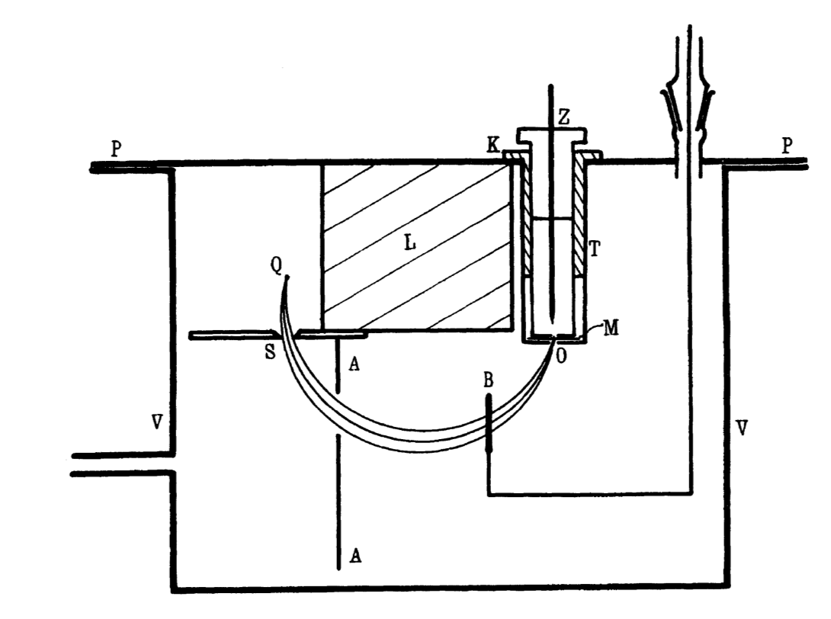
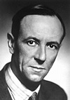
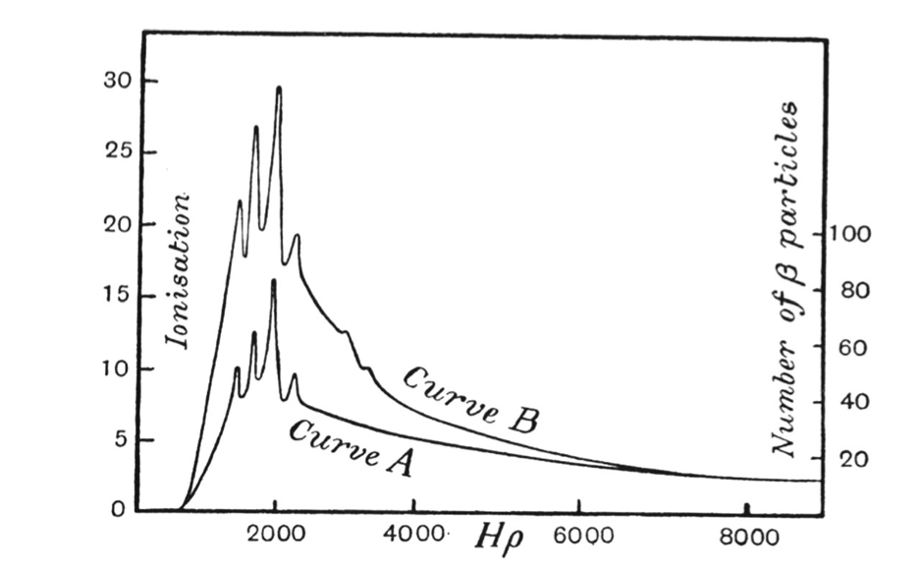
Continuity as well as lines !
James Chadwick
J. Chadwick, "Intensitiitsverteilung im magnetischen Spektren der beta-Strahlen von Radium B + C," Verh. d. D. Phys. Ges. 16 (1914), 383-391
[²¹⁴Pb+²¹⁴Bi]

Slide 19
Interlude….
World War I

Slide 20
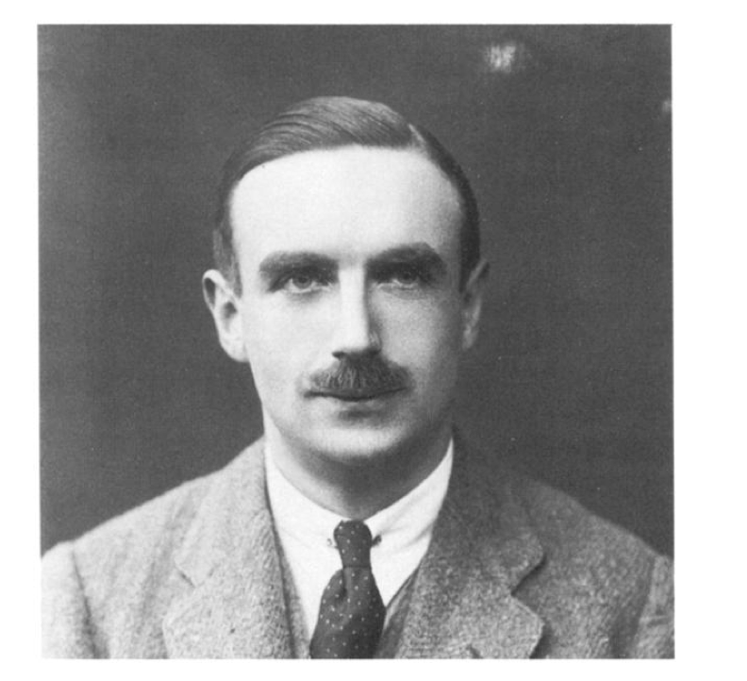
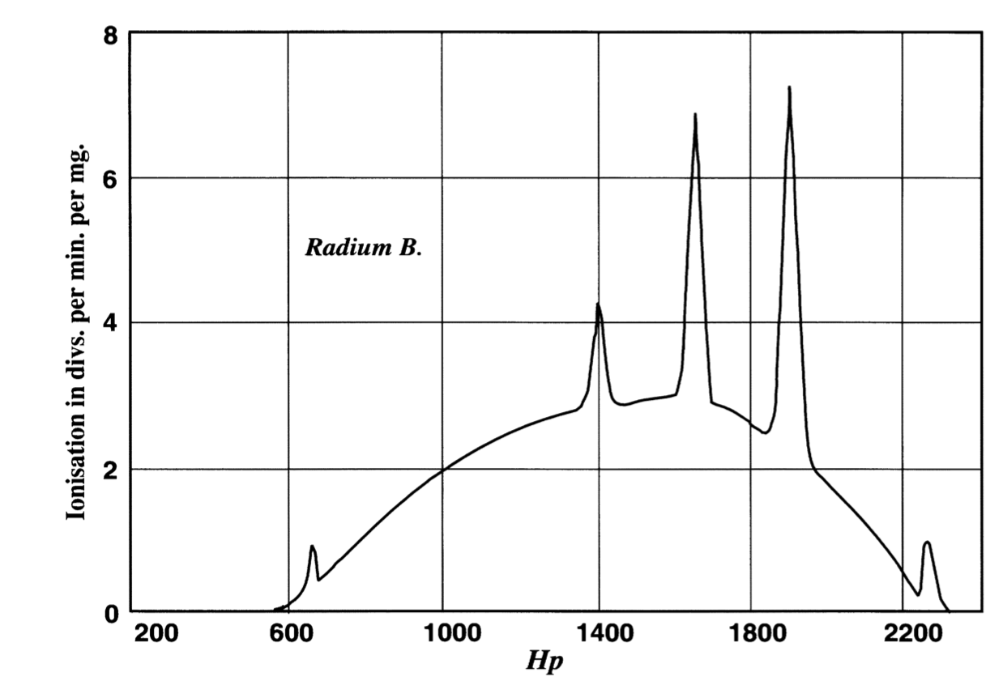
Internal conversion
Ellis takes up the experiments started by Rutherford, Robinson and Rawlinson before WWI
RaB
gamma
RaB
beta
Pb
beta
Charles Drummond Ellis
gamma
Coud it be due to a conversion of W=hν into electronic form ?

Slide 21
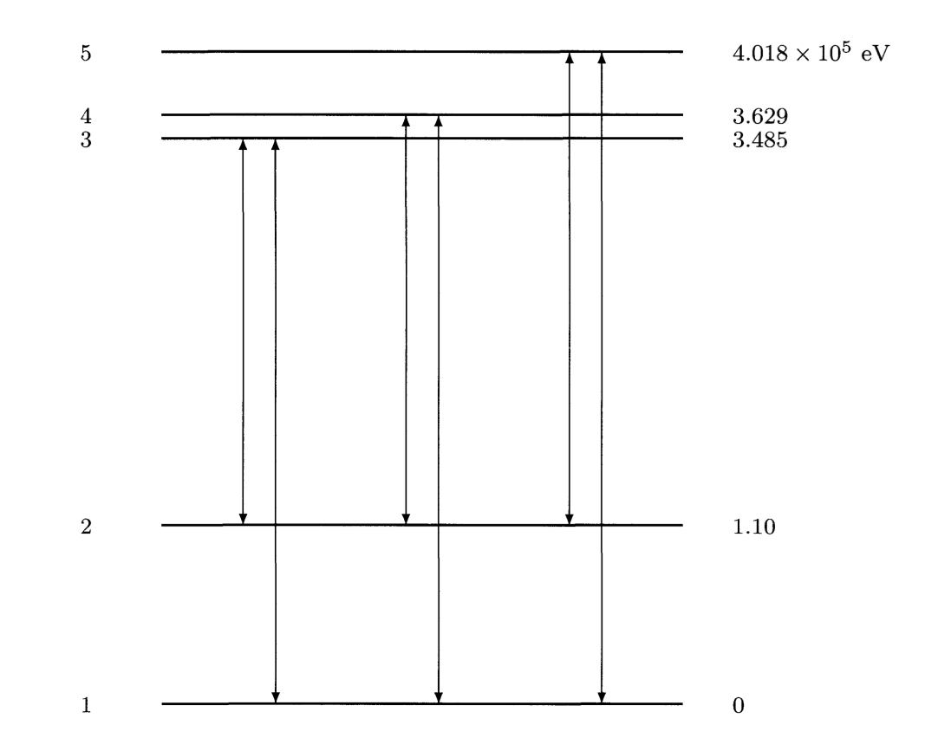
Internal conversion & birht of nuclear spectroscopy
By systematic measurements on Ba, W, Pt, Pb and U, Ellis showed that the observed beta-line energies could be connected through Einstein’s photo-electric relationship to n=6 gamma rays of RaB
E_{e} = W_{n} – W_{a}
(W_{a} known from Xray studies)
Given their energy, the gamma rays must have their origin in the nucleus and must correspond to transitions between stationary states of the nucleus
RaB [=²¹⁴Pb]
For Ellis, the emission of gamma rays precedes the emission of the beta spectrum
C.D. Ellis, « Beta-Spectra and their Meaning," Proc. Roy. Soc. A101 (1922), 1-17

Slide 22
The Ellis-Meitner Controversy
Meitner is still convinced the primary beta spectrum is not continuous (in analogy to alpha decay) and that the gamma rays are emitted after the radioactive decay
« One fraction of these beta rays passes through the atom unchanged and is measured outside the atom with its full velocity. The other fraction is transformed in the nucleus into gamma rays of corresponding frequency, and the gamma rays eject electrons from the electron rings, which have different velocities depending upon the ionization work performed and which form the secondary part of the beta-ray spectrum. »
For Meitner, the continuous spectrum is due to secondary processes in the electronic system and in the measuring apparatus.
L. Meitner, "Uber die Entstehung der ,Beta-Strahl-Spektren radioaktiver Substanzen," Z. Phys. 9 (1922), 131-144.

Slide 23
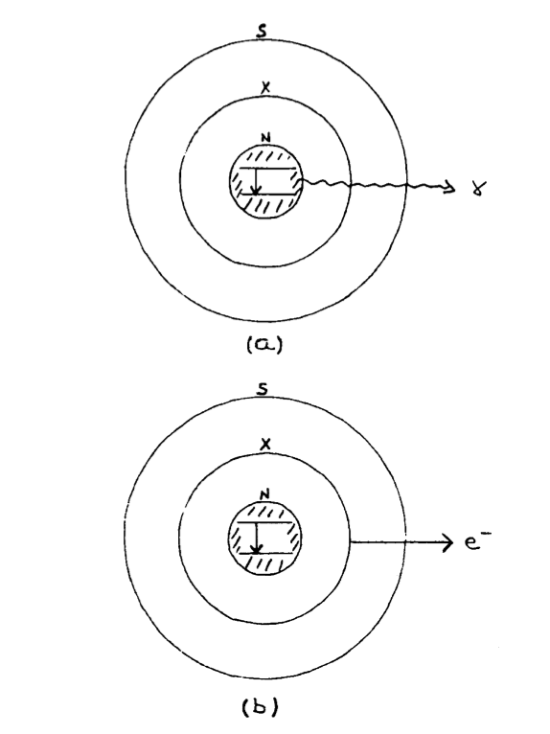
Emerging theories
Atom = jointly quantized system
of the nucleus + surrounding electrons
=> radiationless nuclear transitions
A. Smekal, "Zur quantentheoretischen Deutung der beta und gamma-Strahl-Emission," Z. Phys. 10 (1922), 275-302
Rosseland imagines that radiationless transitions can also occur in the nucleus
S. Rosseland, "Zur Quantentheorie der radioaktiven Zerfallsvorgange," Z. Phys. 4 (1921), 173-181, p. 173

Slide 24
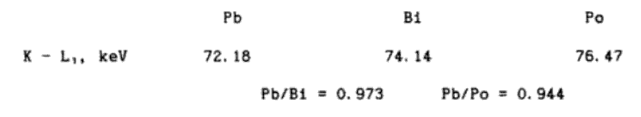
First gamma then beta or the other way around ?
In Berlin, the key to the solution was to investigate the beta-line spectra from alpha sources
Meitner studies the beta-line spectrum of Radioactinium [=²²⁷Th] and Actinium X [=²²³Ra] and proves that the beta-line emission occurs in the daughter nucleus
L. Meitner, "Die Gamma-Strahlung der Actiniumreihe und der Nachweis dass die Gamma-Strahlen erst nach erfolgtem Atomzerfall emittiert werden," Z. Phys. 34 (1925), 807-818

Slide 25
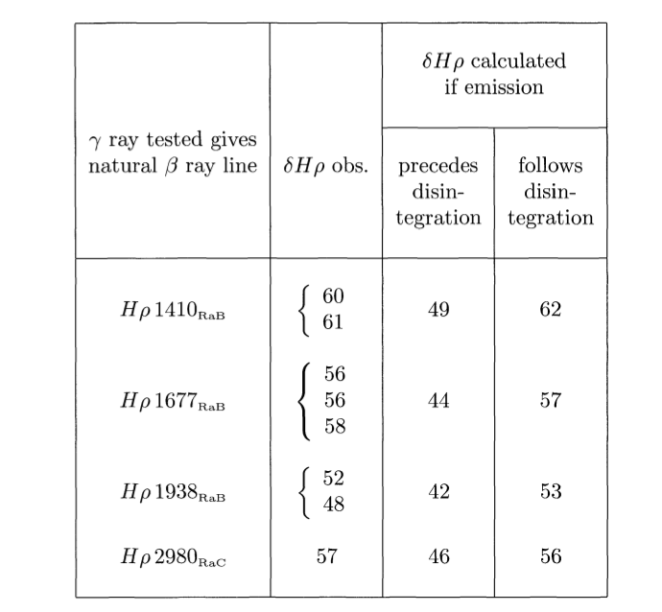
First gamma then beta or the other way around ?
Ellis and Wooster prove that the beta-line spectrum of RaB corresponds to atomic number 83 (and not 82!)
C.D. Ellis and W.A. Wooster, "The Atomic Number of a Radioactive Element at the Moment of Emission of the gamma-Ray," Proc. Camb. Phil. Soc. 22 (1923-25), 844-848
Simultaneous measurement of the natural beta spectrum of RaB together with the one of Pt excited by the gamma rays of RaB:
E_{Pt}-E_{Ra} = K_{RaB or} _{C} - K_{Pt}
=> gamma rays are emitted after the nuclear change has taken place

Slide 26
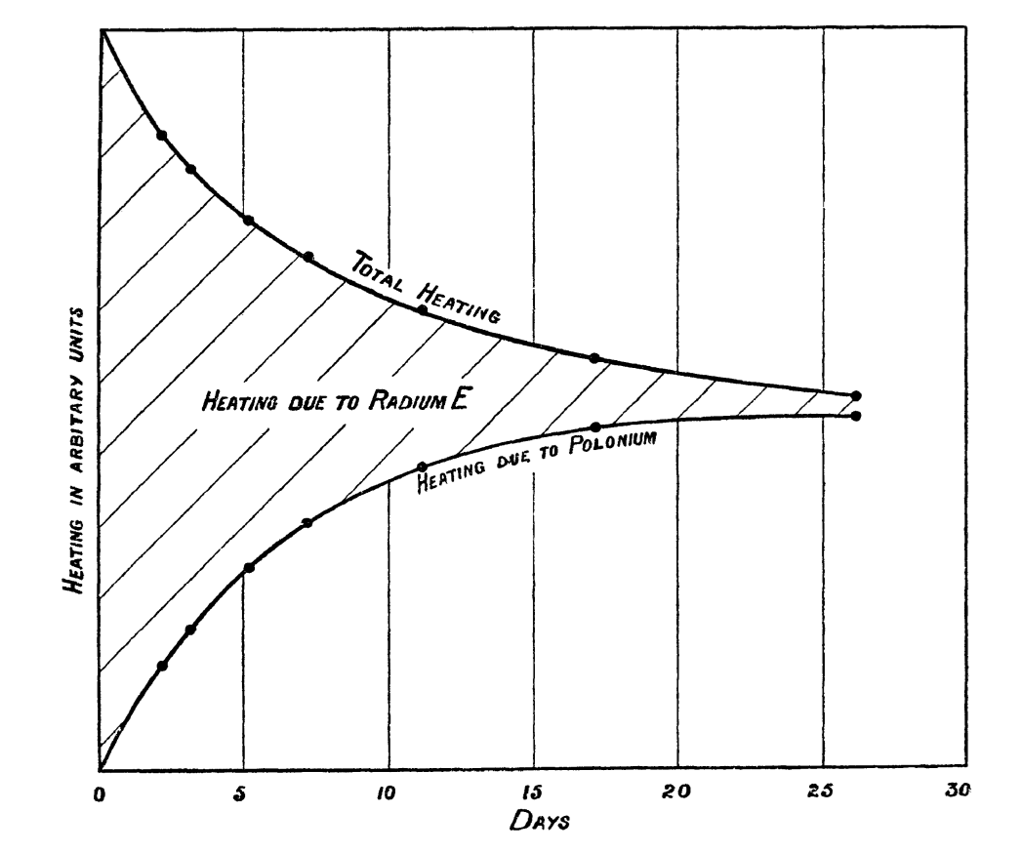
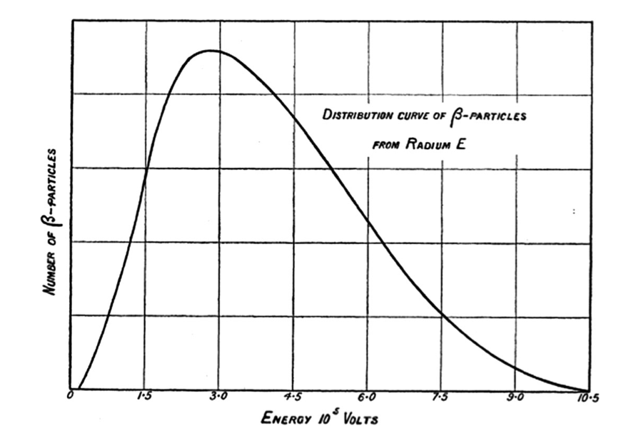
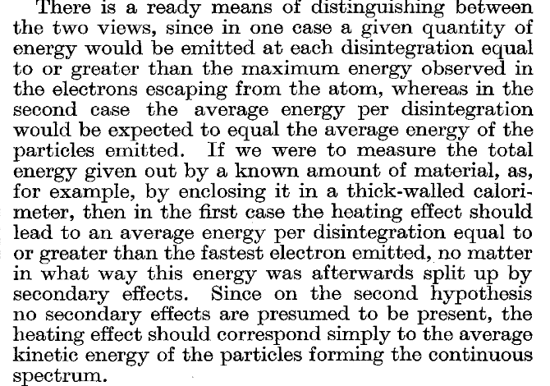
The continuous nature of the beta spectrum is real !
[=²¹⁰Bi]
C.D. Ellis and W.A. Wooster, "The Average Energy of Disintegration of Radium E," Proc. Roy. Soc. A 117 (1927), 109-123.
Average Energy = 340 000 V
1930: W. Pauli suggests the existence of a new neutral, ~massless particle, which he calls ‘neutronen’ and which would share the β-decay energy with the e⁻
1934: E. Fermi suggests the existence of a new force, the weak force, and derives a theory for β decay

Slide 27
Back to the beta-line spectrum & internal conversion
First quantum mechanical treatment of internal absorption of gamma rays from K levels by Bertha Swirles assuming a Hertzian doublet placed at the center of the atom: values are ~10 times too small
Internal-absorption coefficients show no systematic dependence on λ. Moreover, the internal-absorption coefficients are usually several orders of magnitude larger than the external-absorption coefficients
B. Swirles, "The Internal Conversion of Gamma Rays," Poc. Roy. Soc. A116 (1927)
C.D. Ellis and C.H. Aston, "The Absolute Intensities and Internal Conversion Coefficients of the Gamma Rays of Radium B and Radium C," Proc. Roy. Soc. A129 (1930), 180-207
« We have no hesitation in abandoning the hypothesis of only radiative coupling between the nucleus and electronic system, in fact our results point directly to a direct action of the nucleus on the electronic structure. »

Slide 28
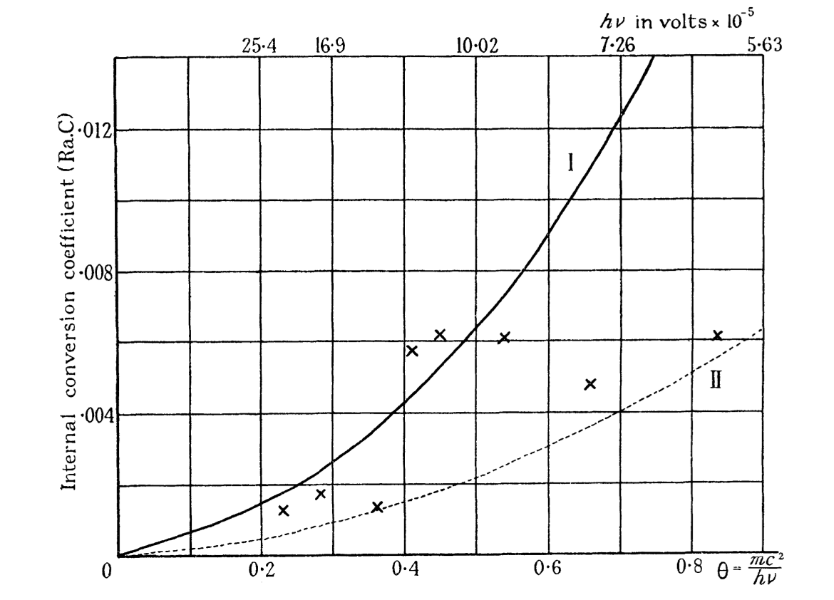
Towards a theory of internal conversion (1)
Interaction of electrons in the vicinity of the nucleus required to explain the factor 10 discrepancy: « penetration » effects
H.R. Hulme, "The Internal Conversion Coefficient for Radium C," Proc. Roy. Soc. A138 (1932), 643-66
4
Quadrupole electric field is necessary to reproduce some conversion coefficients of Radium C [=²¹⁴Bi]
H.M. Taylor and N.F. Mott, "A Theory of the Internal Conversion of gamma-Rays," Proc. Roy. Soc. A138 (1932), 665--695.
First use of internal conversion coefficients in the determination of angular momentum changes in nuclear transitions
Internal conversion loses its meaning: gamma-ray and internal-conversion-electron emission are 2 independent competing processes

Slide 29
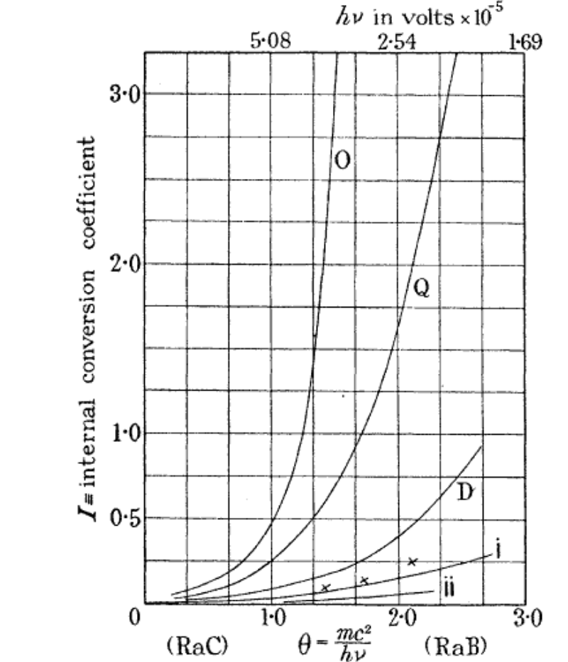
Towards a theory of internal conversion (2)
« It is shown that in addition to the fields of radiation which have formerly been assumed, those of electric multipoles, a nucleus may also emit those due to magnetic multipoles, and will in fact emit a combination of both »
J.B. Fisk and H.M. Taylor, "The Internal Conversion of gamma Rays," Proc. Roy. Soc. A146 (1934), 178-181
Higher multipole fields invoked to explain nuclear isomerism (discovered by O. Hahn in 1921)
C.F. v. Weizsäcker Naturw., 24 (1936), p. 813
i=E2, ii=E1, D=M1, Q=M2

Slide 30
Some properties of Internal Conversion

Slide 31
Electromagnetic decay
γ
IPF
ICE
M
L
K
Emission of a γ-ray is caused by the interaction of the excited nucleus with an electromagnetic field
Besides γ-decay, the electromagnetic perturbation can also induce nuclear decay through internal conversion whereby one of the atomic electrons is ejected
The decay can also proceed by creating an electron-positron pair (internal pair creation)
Higher order effects are very weak: for example 2 photon emission

Slide 32
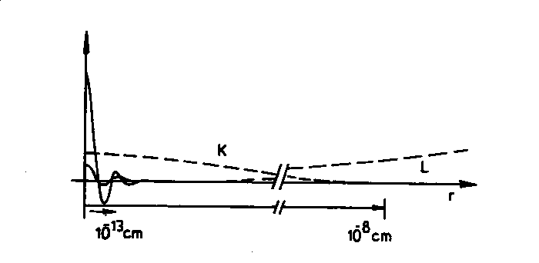
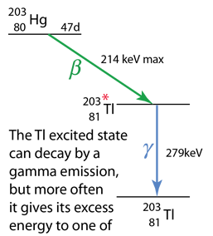
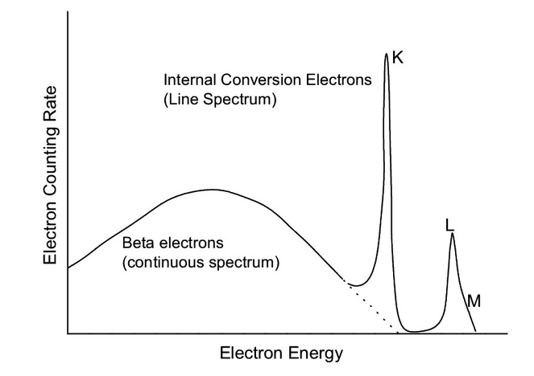
Internal conversion
Picture taken from T. Kibedi
M
L
K
r
Electron kinetic
energy
Electron binding
energy
Inner-shell electrons spend a large fraction of their time in the vicinity of the nucleus, the source of the EM field.
Exchange of virtual photon : the process can occur between I=0 states – but only by interaction of the nuclear charge and the e when it is INSIDE the nucleus

Slide 33
Internal conversion coefficients
α_{i} depends on the transition energy and its electromagnetic character
Mixed multipoles:
=> Mixing ratios can be deduced by measuring conversion coefficients
Only E0 allowed for 0+ → 0+ or 0⁻ → 0⁻ transitions
For I → I (I≠0), transitions can be mixed:

Slide 34
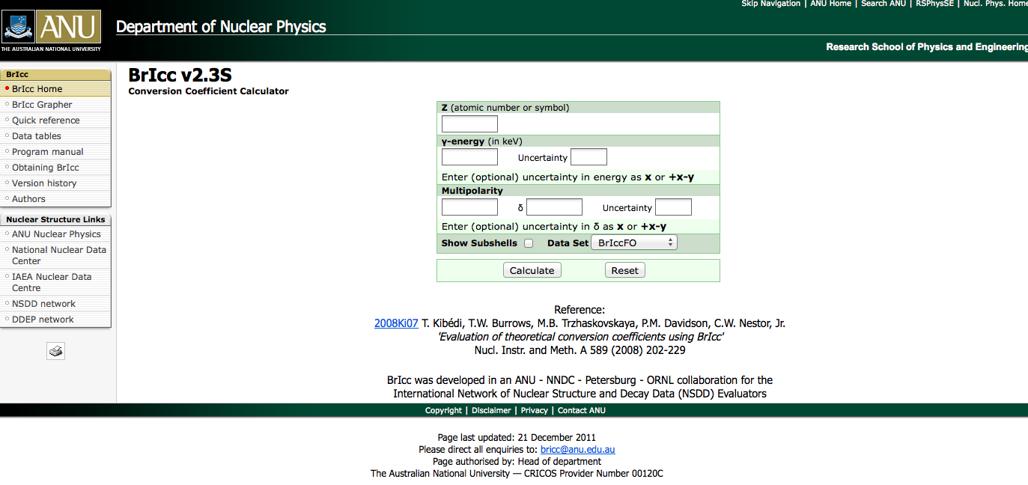
Theoretical internal conversion coefficients
α_{i} depends on
Transition energy (E)
Atomic number (Z)
Multipole order (L; the angular momentum carried away)
Electric (EL) or magnetic (ML) character
The shell or subshell the electron is ejected (n)
Atomic screening
Nuclear structure effects (penetration)
http://bricc.anu.edu.au/

Slide 35
Internal-conversion coefficients for Z=102
e⁻ emission dominates
γ-ray emission dominates

Slide 36
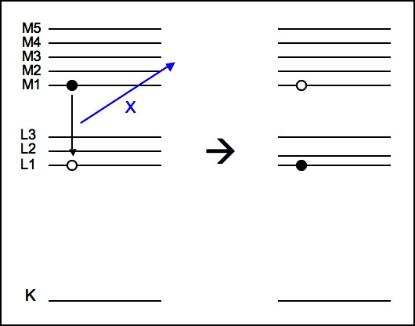


Atomic relaxation following internal conversion
Fluorescence (X ray emission)
Auger e- emission
Many electrons emitted
Highly ionised atom after relaxation
Coster-Kronig transition

Slide 37


Radiative & non-radiative yields
Following a vacancy in the K shell:
Following a vacancy in the L1 shell:
El ω_{K} ω_{L1} ω_{L2} ω_{L3} f₁₂ f₁₃ f’₁₃ f₂₃

Slide 38
Experimental techniques
(with a focuss on heavy/superheavy nuclei)

Slide 39
Complementary techniques
Target
Decay station
Beam
Filter/transport
Recoiling
Heavy Nuclei
Electromagnetic decay from
excited nuclear states
Ground state & isomeric decays

Slide 40



In-beam internal conversion spectroscopy
1) Mini-orange spectrometers (MOS)
Small size & portability - Transmission depends on e- energy
Suppression of low-energy electrons; Low detection efficiency below ~ 200 keV

Slide 41



Spectroscopy in the 2nd well of ²⁴⁰Pu with the ICEMOS setup
²³⁸U(α,2n)²⁴⁰Pu
e- in delayed coincidence with fission fragments
ε(600 keV)=5.4%
FWHM ~3 keV
D. Gassmann et al., Phys. Lett. B 497 (2001) 181

Slide 42


Shape coexistence in ¹⁸⁸Pb with ICEMOS
3 MOS + 4 Compton suppressed Clover detectors + RITU separator
¹⁵⁶Gd(³⁶Ar,4n)¹⁸⁸Pb
Y. Le Coz et al., Eur. Phys. J. (Direct)A 3 (1999) 1

Slide 43

In-beam internal conversion spectroscopy
2) Solenoid spectrometers with superconducting/normal conducting coils
beam
Broad energy transmission
To minimize Doppler broadening and background of delta rays:
- Solenoildal field axis ~ colinear with the beam direction
- Detector at backward angles
- HV barrier
SACRED
H. Kankaanpää et al., Nucl. Instr. Meth. A 534 (2004) 503–510
HV barrier
C foils
to RITU
target chamber

Slide 44



In-beam internal conversion spectroscopy
Segmented Si detector
Distribution of e⁻ flux over the detector
Close to normal incidence => reduced backscattering

Slide 45
Conversion electron spectroscopy of ²⁵⁴No
²⁰⁸Pb(⁴⁸Ca,2n)²⁵⁴No
SACRED coupled to RITU separator
Physical background due to the conversion of other highly-converted rotational sequences
P. Butler et al., Phys. Rev. Lett. 89 (2002) 202501

Slide 46

Why continuous background ?
E(I)=A ( I(I+1) – K²) + E₀
8
ΔE between 2 consecutive E2s = 8A ~ 60 keV
ΔE between 2 consecutive M1s= 2A ~ 10 keV
7
6
8
5
4
3
6
Eγ
L
M
N
4
L binding~30 keV
M binding~7 keV
N binding~2 keV
2
0
Ee

Slide 47



Complex odd nuclei
²⁰⁷Pb(⁴⁸Ca,2n)²⁵³No
R.D.Herzberg et al.,Eur.Phys. J. A42 (2009) 333
R. Herzberg et al., J. Phys. G: Nucl. Part. Phys. 30 (2004) R123

Slide 48




Silicon And GErmanium
J. Pakarinene et al., Eur. Phys. J. A 50 (2014) 53

Slide 49


Delayed internal conversion spectroscopy
Compact array of Si detectors around catcher (which can be active)
GABRIELA
GREAT@RITU
¹⁶⁹Tm( ³⁶Ar, 4n) ²⁰¹Fr
R. Page et al., Nucl. Instr. Meth. B 204 (2003) 634
Identification of 13/2⁺ isomer in ²⁰¹Fr via its M2 decay to the ground state
K. Auranen et al., Phys. Rev. C 101 (2020) 024306

Slide 50


Delayed internal conversion spectroscopy
GABRIELA@SHELS
K. Hauschild et al., Nucl. Instr. Meth. A 560 (2006) 388
γ
e⁻
recoils
R. Chakma et al., Eur. Phys. J. A 56 (2020) 245
Backscattering -> characteristic spectral shape
Low energy detection efficiency depends on implantation depth
=> shallow implantation depth for ICE spectroscopy

Slide 51



Delayed internal conversion spectroscopy
EC
α
⁴⁸Ca(²⁰⁹Bi,2n)²⁵⁵Lr → ²⁵⁵No → ²⁵¹Fm; 5/2⁺ isomer decay
+0.20
δ(Ε3/Μ2) = 0.76
=> B(E3)= 18(6) W.u.
-0.19
K. Rezynkina et al., Phys. Rev. C 97 (2018) 054332

Slide 52



Delayed internal conversion spectroscopy
Decay stations
α
²⁴⁸Cm(¹³C,4n)²⁵⁷No → ²⁵³Fm
Fine structure alpha decay to ²⁵³Fm
77 and 124 keV transitions are proven to be M1s
=> ²⁵⁷No ground state is assigned J^{π}=3/2⁺
M. Asai et al., Phys. Rev. Lett. 95 (2005) 102502

Slide 53


In-trap conversion-electron spectroscopy
REXTRAP
B
detector
e-
A=10 mm²
D=500 μm
FWHM~2 keV
V
electron-particle energy
L. Weissman et al., Nucl. Instr. and Meth A 492 (2002) 451

Slide 54
Some issues of internal conversion…

Slide 55



Internal conversion and fine structure α spectroscopy
²³⁸U(²²Ne,5n)²⁵⁵No F. Hessberger et al., Eur. Phys. J. A29 (2006) 165
Stop detector
ER
α
e-
γ
e-
²⁴⁸Cm(¹²C,5n)²⁵⁵No, Asai et al., Phys. Rev. C 83 (2011) 014315

Slide 56

Internal conversion and fine structure α spectroscopy
²³⁸U(²²Ne,5n)²⁵⁵No F. Hessberger et al., Eur. Phys. J. A29 (2006) 165
Stop detector
ER
α
e-
γ
e-
M. Asai, F.P. Hessberger and A. Lopez-Martens. Nucl. Phys. A 944 (2015) 308

Slide 57

Summing effects – always present to some extent….
M. Asai et al., Phys. Rev. Lett. 95 (2005) 102502

Slide 58

Alpha spectroscopy of implanted species
DSSD
α
Recoil
ICE
25 μm at 50 keV
The distortion of the alpha-particle spectrum will depend on the energy and electromagnetic nature of the transitions in the daughter nucleus and on the implantation depth in the Si detector

Slide 59

Case of ²⁵³No→²⁴⁹Fm
plastic degrader foil
Stop detector
ER
α
e-
γ
e-
²⁵³No
gs
8003
279
9/2-
8280
129
11/2+
58
9/2+
0
7/2+
F.P. Hessberger et al., Eur. Phys. J. A 48 (2012) 75
²⁴⁹Fm

Slide 60
Case of ²⁵³No→²⁴⁹Fm
²⁵³No
gs
8003
279
9/2-
8280
129
11/2+
58
9/2+
0
7/2+
A. Lopez-Martens et al., Phys. Rev. C 74 (2006) 044303
²⁴⁹Fm

Slide 61




How to interpret α−γ coincidences…
²⁸⁰Rg −> ²⁷⁶Mt
D. Rudolph et al., Phys. Rev. Lett. 111, 112502 (2013)
J.M. Gates et al, Phys. Rev. C 92, 021301 (2015)

Slide 62




Summing and α-decay branching ratios
TASISPEC@SHIPTRAP
Ch. Lorenz et al., Phys. Rev. C 96, 034315 (2017)
α
α−γ

Slide 63

GEANT4 simulations for heavy & superheavy nuclei
Fig. taken from L. Sarniento et al., Proceedings of the 10th Latin American Symposium on Nuclear Physics and Applications, 2013

Slide 64
A few words about GEANT4 simulations for Z>100
Problem: hard-coded limit on the atomic number of the simulated particles Z ≤ 100
Simple to allow the radioactive decay of a super heavy element but no so easy to include
atomic relaxation processes
Disguise heavy elements as lighter ones with modified atomic binding energies, fluorescence & Auger data files
Modify GEANT4 classes and include new atomic data Files for the elements of interest
Handle the atomic relaxation in the PrimaryGeneratorAction file

Slide 65
Some opportunities given by internal conversion…

Slide 66


Internal conversion and isomers in heavy nuclei
γ
²⁰⁴Hg(⁴⁸Ca,2n)²⁵⁰Fm
e-
P. Greenlees et al., Phys. Rev. C 78 (2008) 021303(R)
α
recoil
e-



E*,I,π
E*,I,π
gs
gs
gs
G.D. Jones, Nucl. Instr. Meth. Phys. Res. A 488 (2002) 471-472

Slide 67
Internal conversion and isomer-decay trigger
-identification of 8- isomer
-access to otherwise inaccessbile states
²⁵⁰Fm

Slide 68

Internal conversion and isomer-decay trigger
²⁰⁸Pb(⁴⁸Ca,2n)²⁵⁴No
R.-D. Herzberg et al., Nature 442 (2006) 896

Slide 69
Internal conversion and lifetime measurements
target
foil
Vacuum separator
beam
Ions after internal conversion
+ atomic relaxation
Ions passing through a carbon foil
V.S. Nikolaev and I.S. Dmitriev, Phys. Lett. 28A (1968) 277
α=0.45, k=0.6, v’=3.6 10⁸ cm/s
charge
charge

Slide 70
Charge state distribution
target
foil
Q_{low}
IC
x
charge
Q_{high}
IC
charge
The charge state distribution will be composed of 2 components whose relative intensities depend on the time of the nuclear decay. By measuring the distribution as a function of target-reset foil distance, one can determine the lifetime of the decay

Slide 71


More than one emitting state
Figs. Taken from J. Heery et al., Eur. Phys. J. A 57 (2021) 132
Need to solve the appropriate Bateman equations with more free parameters

Slide 72


Charge plunger
G. Ulfert et al., Nucl. Instr. Meth. 148 (1978) 369
Measurement of lifetimes in the 2nd well of ²³⁹Pu in the ²³⁸U(α,3n) reaction
-> first proof of shape isomerism

Slide 73


Charge plunger at MARA
¹⁵²Sm(³²S,6n)¹⁷⁸Pt, ionic charge states measured at the focal plane of MARA
¹⁷⁸Pt ions selected via their characteristic α decay
12 target-foil distances
2 charge states chosen to represent Q_{low} (17e) and Q_{high} (25e)
J. Heery et al., Eur. Phys. J. A 57 (2021) 132
τ(2⁺)=430(50)ps
τ(4⁺)= 54(6) ps

Slide 74
Conclusions
Internal conversion spectroscopy was instrumental in understanding the structure of the nucleus
Internal conversion allows to unravel the nature of nuclear transitions and becomes an important process in the heaviest nuclei
Internal conversion spectroscopy is challenging due to delta rays and complex spectra of overlapping peaks
Internal conversion makes alpha spectroscopy complicated
Internal conversion can provide very unique ways to access otherwise inaccesible states
Internal conversion changes the charge state of ions, which can be exploited to measure lifetimes

Slide 75



Perspectives
New prospects for SHE with charge plunger measurements at MARA
New decay setups coming on line soon: SIRIUS@S3, SEASON@S3-LEB,
LUNDIUM & ANSWERS@TASCA, …
New ideas: SHEXI, Daring @ MLLTrap
2 Ge detectors
EXOGAM
2 Si detectors
Long T_{1/2} station
11 Implantation foils
LUNDIUM
SIRIUS
Laser ionized atoms
5 Si detectors
Main station
SEASON
Vacuum chamber

Slide 76


SHEXI@SHELS
Replace the tunnel detectors of GABRIELA by high-resistivity thick Si segmented detectors coupled to ASICS used in the field of high-resolution Xray spectroscopy
x10
Sub-keV resolution for Lxrays, x3 better e- resolution

Slide 77



DARING@MLLTrap
In-trap alpha spectroscopy combined with out-of-trap e- detection to measure lifetimes of states following alpha decay
α
e-
d
D
e-
C. Weber et al., International Journal of Mass Spectrometry 349–350 (2013) 270–276
P. Chaveau et al., Nucl. Instr. Meth. A 982 (2020) 164508

Slide 78


Phyiscs cases
1) Decay of 2⁺ states in deformed nuclei
2) Decay of 0⁺ states
¹⁹⁰Po
A. Andreyev et al. Nature 405 (2000) 430

Slide 79
The End
Thank you for your attention

